Slide 1

September 16, 2015
Chapter
Opening
Innovate. Disrupt. Transform. Fast.
At Enterprise Scale.
IBM Cloud Garage Method
Chris Lazzaro
@LazzaroChris Lead Architect, Garage Method
clazzaro@us.ibm.com

Slide 2


IBM Bluemix Garage
An unconventional consulting paradigm that dramatically accelerates enterprise customer outcomes in the cloud
“From initial concept to where we are today… nothing has fit any traditional IBM patterns. And when people say ‘you can’t do that at IBM’ I point to the Garage team and say nothing that they’ve done would a normal person say you could do at IBM – and they’ve pulled it off.”
Steve Robinson
General Manager
Client Technical Engagement
IBM Cloud

Slide 3



Give enterprise consulting a makeover
Inspired by startups, we realized that we needed a different approach to help enterprises be successful in the cloud
The pace and complexity of the traditional waterfall approach makes it unfavorable for delivering cloud-based projects
The size, complexity and conventions of enterprises make the agile approach impractical to fully commit to and implement
Our approach
Add startup behaviors to how we work – and how we work with clients
Create a methodology and a physical place in which to immerse clients in our methodology
Bring startup energy, techniques and focus to enterprises

Slide 4
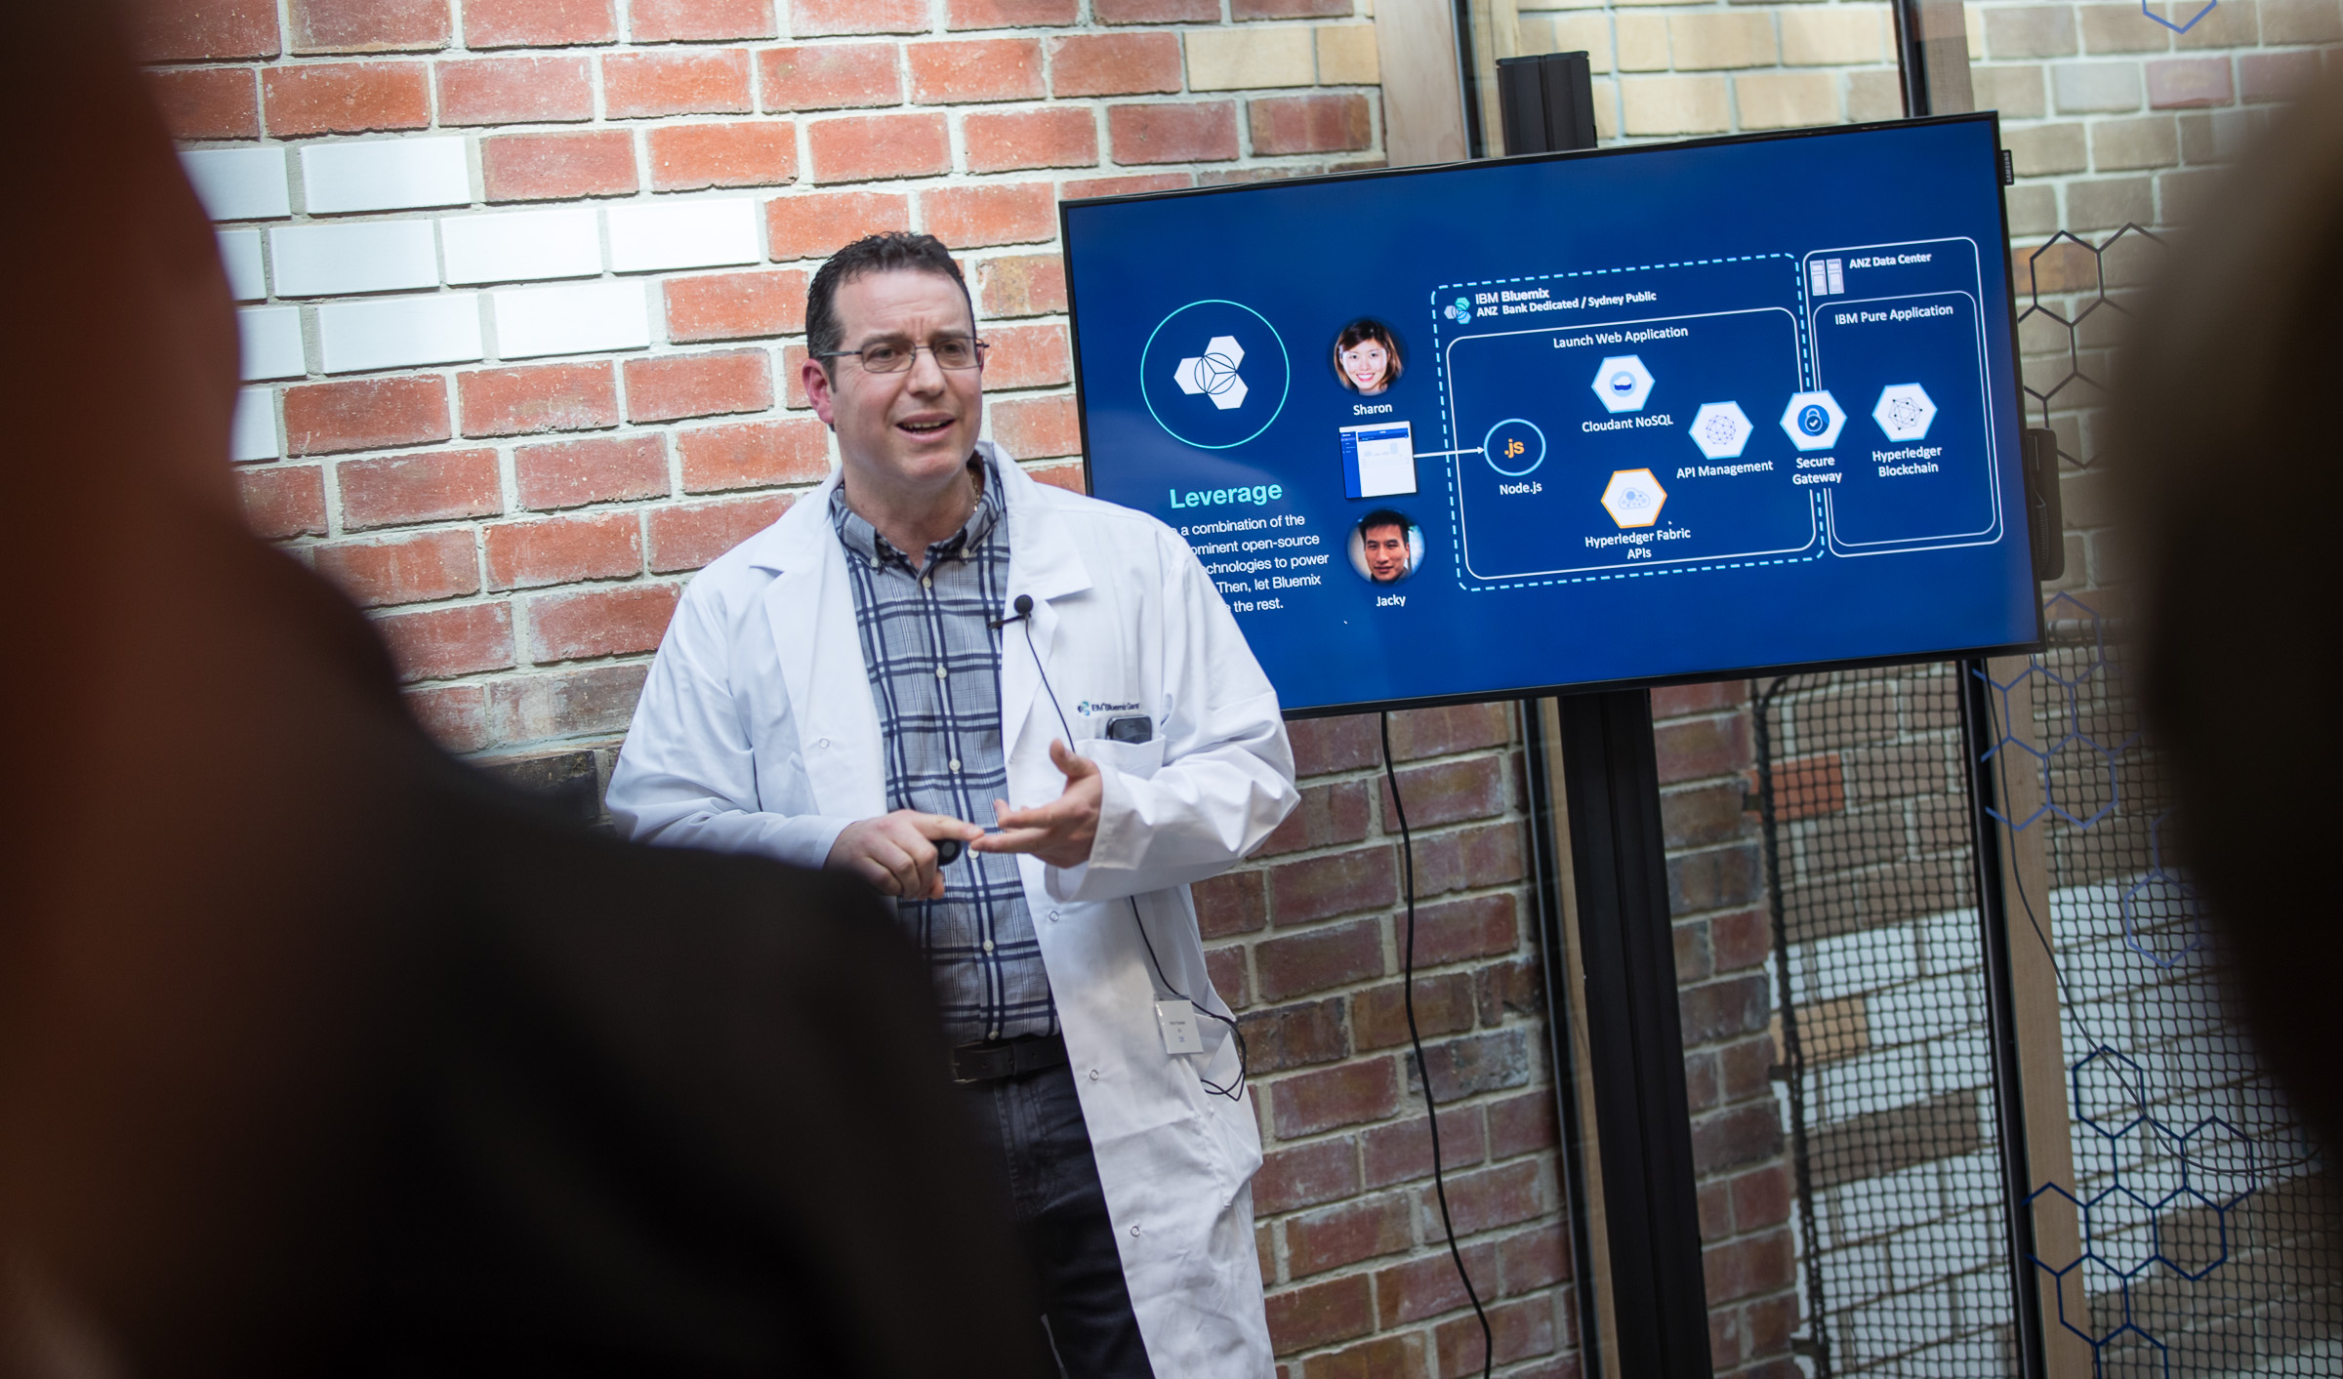
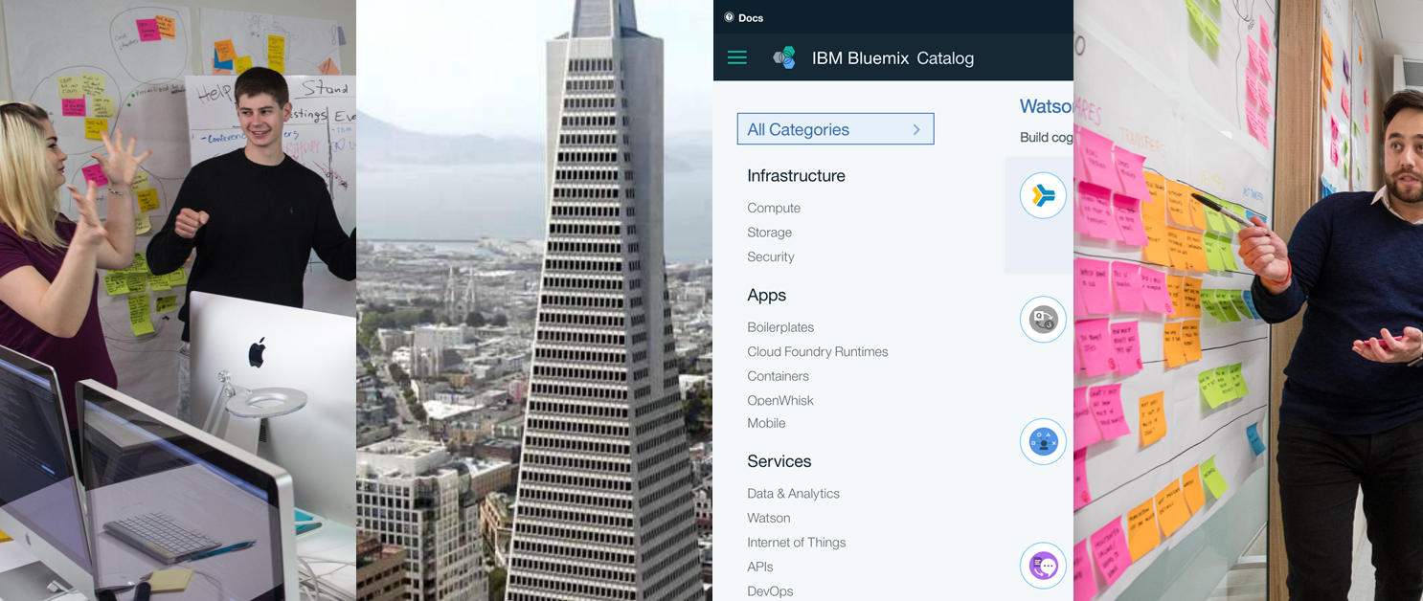

IBM Bluemix Garage
IBM’s consultancy with a startup DNA.
Built on four foundational pillars
Places Platform People Practice
4

Slide 5

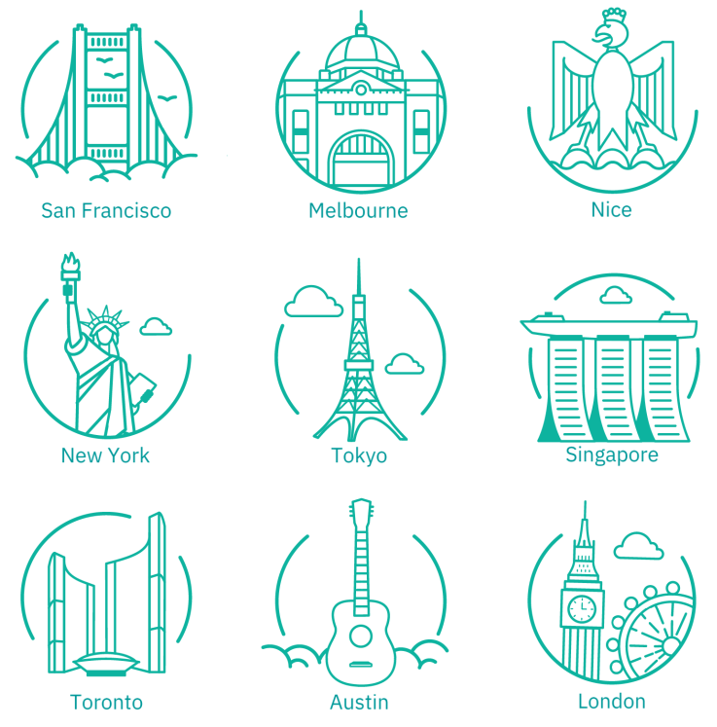

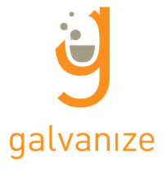


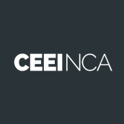
Garages are embedded in the world’s largest startup communities
Places
5

Slide 6
IBM Bluemix is the technology that makes fast outcomes possible
IBM Bluemix is built on the most prominent open source compute technologies:
Cloud Foundry, Docker, OpenStack
IBM Bluemix enables:
Rapid development
Rapid integration
Rapid deployment with built-in DevOps
Rapid application of new ideas by provisioning high-value capabilities and services (Watson, Blockchain, IOT services)
Platform
IBM Bluemix empowers the business and development to go as fast as they want to go
6

Slide 7
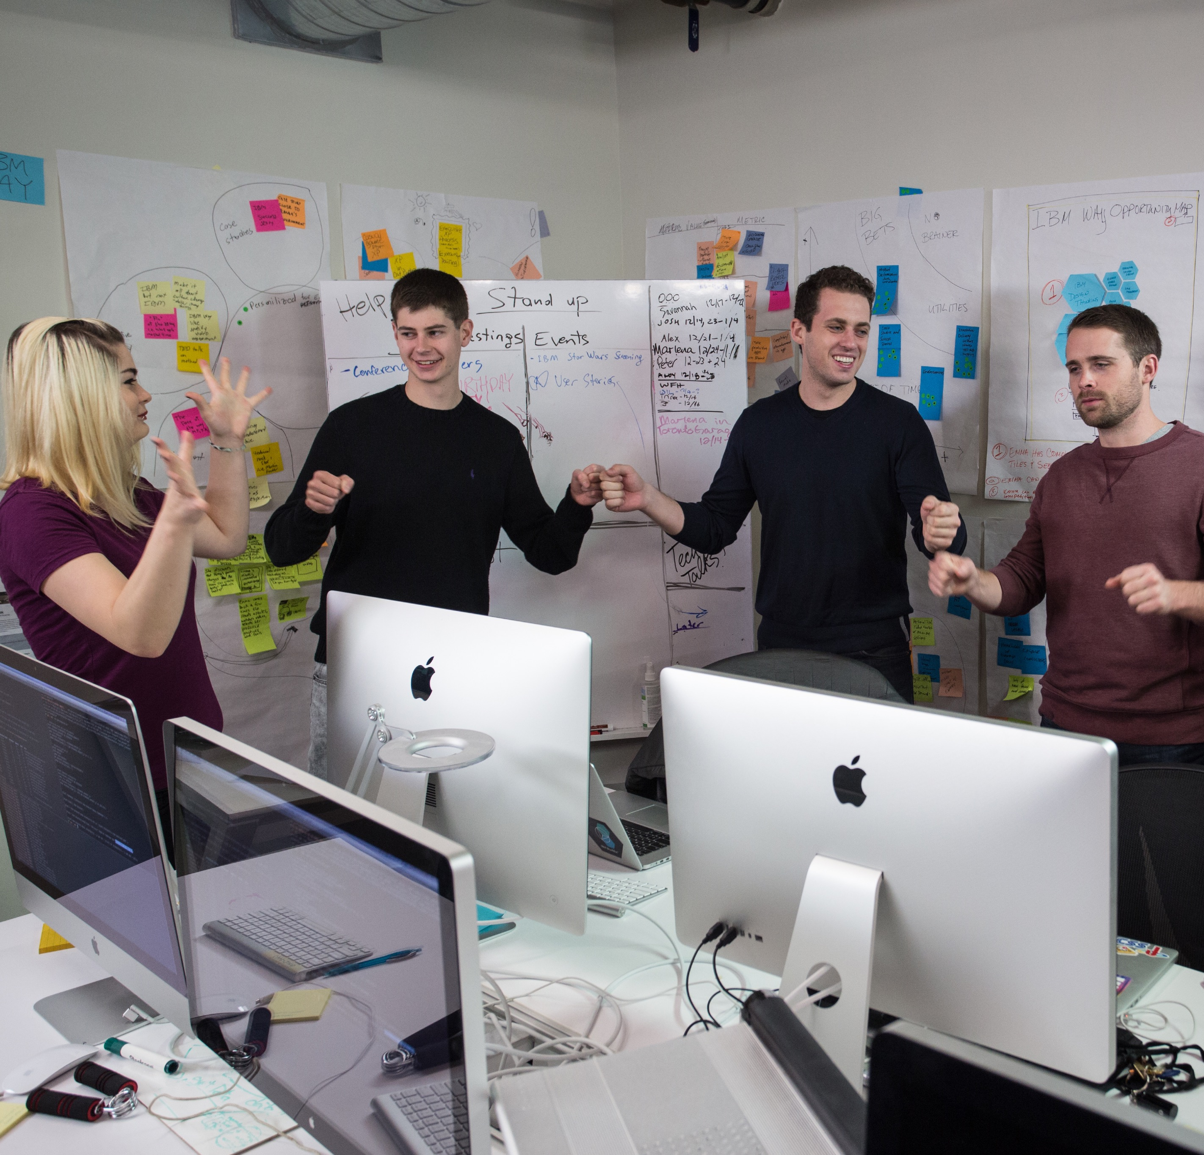
Diverse skills, disciplines and viewpoints
Core to the Garage is the project team that is formed to enable the client to transform for the cloud, build applications, and manage IT
Client team members include key stakeholders from business and IT
A business owner, empowered by the business sponsor, decides how the application will be shaped
Garage designers, programmers, architects, practice and technology specialists from across IBM fill out the team
Who’s in the Garage
UX designers | Developers | Enterprise veterans
Architects | User researchers | Cognitive specialists
Project managers | College hires | Visual designers
Engagement managers | Security integrators
People
7

Slide 8
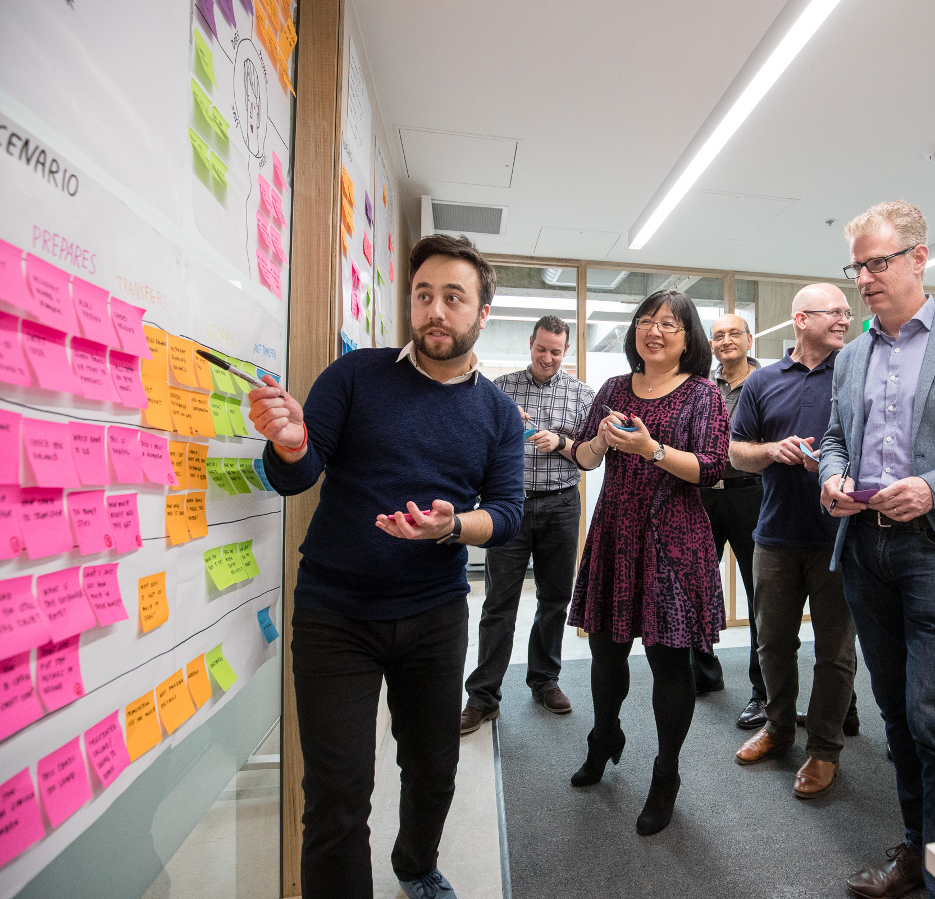
Making the Method
A customer-centric innovation lifecycle experience that starts with an idea and produces a tangible production pilot outcome
Begin with the client’s real-world idea, problem, application, opportunity
Shift the client’s project perspective to a customer-centric approach
Focus on lean startup design
IBM Design Thinking Workshop employs empathy, storyboarding, ideation, prioritization
The Method is a prescriptive path for development with a core set of practices
Explore potential outcomes
Build a backlog
Continuously deliver value to the user
Practice
8

Slide 9
How can we deliver the right outcomes at the speed the market demands?

Slide 10
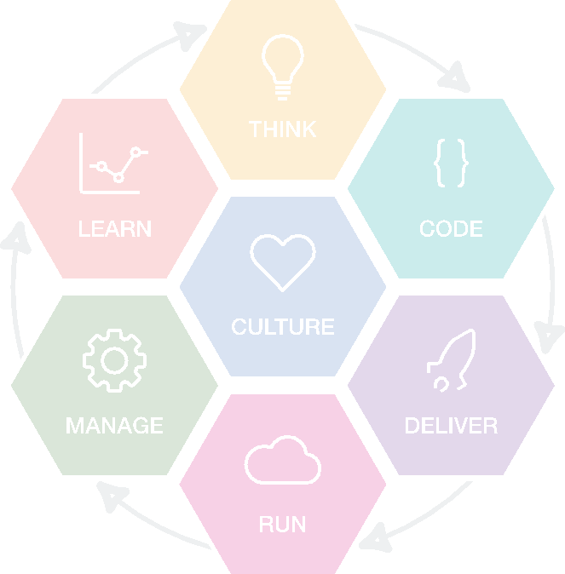
IBM Cloud Garage Method
A proven, comprehensive process that delivers outcomes
Clients are drawn to the Method because it is a defined and proven process – which our competitors universally lack – making it perhaps our most significant differentiator
Clients witness how the Method:
Brings together priorities from within their organizations
Rapidly produces the outcomes that they – and their customers – really need
Transforms their organizations to take advantage of technology in the best way possible

Slide 11
IBM Cloud Garage Method
Think
Conceptualize, refine and prioritize capabilities
IBM Design Thinking
Rank ordered backlog
Playbacks
Define minimum viable product
Core practices
Culture
Foundational values and principles
Agile principles
Organizational roles
From waterfall to continuous delivery
Code
Generate, enhance, optimize and test features
Learn
Continuously learn based on outcomes from experiments
Pair programming
Test-driven development
Continuous integration
Automated testing
A/B testing
Hypothesis-driven development
Efficient DevOps through analytics
Deliver
Automated production and delivery of offerings
Manage
Ongoing monitoring, support and recovery
Continuous delivery
Delivery pipeline
Circuit breaker pattern
Automated monitoring
High availability
Run
Leverage services, options and capabilities required to run in the cloud
Dark launch and feature toggles
Auto-scaling applications

Slide 12
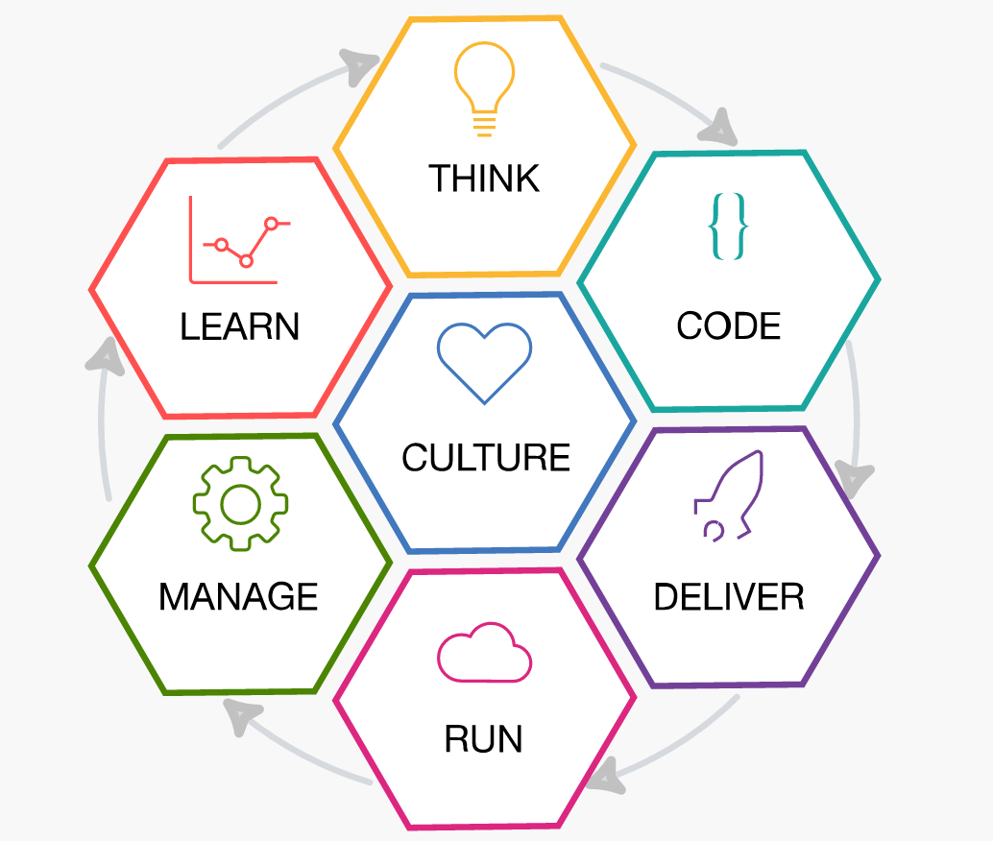
Culture
IBM Bluemix Garage Method
Think Conceptualize, refinement, and prioritization of capabilities
Learn Continuously learn based on outcomes from experiments
Code Generation, enhancement, optimization and testing of features
Culture Foundational values and principles
Manage Ongoing monitoring, support, and recovery of offerings
Deliver Automated production and delivery of offerings
To learn more visit: ibm.com/devops/method
Take a personalized DevOps assessment ibm.biz/devopsassessment
Run Services, options, and capabilities required to run in the Cloud
Notes:
Recently, IBM has undergone a massive business and technology transformation to become a cloud and cognitive services provider. This transformation reaches into all areas of the
business—moving from a development-led culture to a design- and offering-management led culture focused on client experiences and frequent releases.
The transformation draws from best practices that
IBM has learned over many years of establishing methods like remote pairing and tool chains (e.g. Open Stack Continuous Integration/Continuous Delivery (CI/CD)) in open
Communities. Practices that have been tested by thousands of open source developers worldwide. The transformation also builds on IBM’s own Agile development practices, Lean
Startup and IBM Design Thinking.
From this foundation, IBM developed a transformation program that engaged various development organizations at IBM, along with a set of CI/CD tools delivered as a service. The program comprises a leadership bootcamp, followed by a developer bootcamp that immerses development squads in the practices, helping to on-board their teams onto a cloud-based,
centrally hosted CI/CD toolchain.
Gaining leadership support and understanding is a crucial first step, as it helps to remove any lingering doubts about the efficacy of: pairwise development; minimizing distraction;
eliminating data-driven deliverables in favor of a clearly prioritized backlog; or transitioning from a culture that left testing to some other group to one in which all development is fully test-driven.
After the bootcamps are finished, IBM assigns coaches to stay with the teams as they begin to apply the practices, to help them and their leadership through the cultural aspects of the
Transformation.
Combining the best aspects of open communities, Design Thinking, DevOps practices and cultural insights, along with IBM’s experience helping clients to innovate in the Bluemix
Garage and in other engagements, IBM has introduced the IBM Bluemix Garage Method—an open, repeatable method that combines best practices, tool chains and services
partners.
The benefits of innovation, improvements in development practices, and cultural change are not limited to new “greenfield” applications. The Garage Method also provides prescriptive
tracks for innovation, migration and enhancement of existing applications, and mobile-specific recommendations
IBM’s practical method combines the best of open communities, Design Thinking, Lean Startup, with an agile DevOps methodology. An open and repeatable method with best practices, tool chains and a thriving ecosystem. Provides:
Hardened method-ware, delivered as digital experience and practice library of work-product assets.
Accelerators to speed adoption, combining tool chains and methods.
Shared learning (videos, case studies, blogs) of IBM transformation; extends to clients, phase 2.
Open community forum to engage, comment, progress and extend methodology.
The Bluemix Garage Method lifecycle consists of seven phases, as shown on this slide. Each hexagon represents a lifecycle phase with associated practices and tools.
To continuously deliver, you move through the phases of the development cycle.

Slide 13
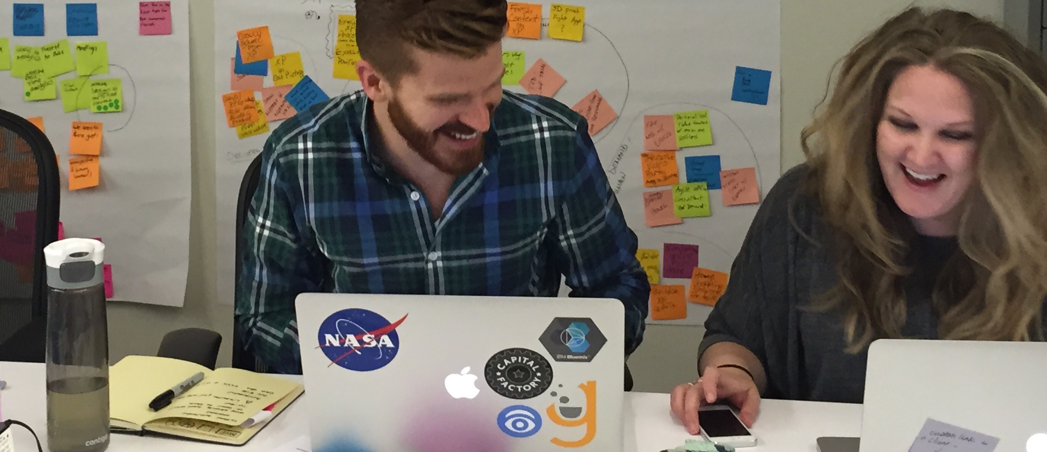
Culture
Agile principles
Diverse Teams
include primary Organizational roles
importance of Autonomous, co-located
Aligning Dev & Ops
Foundational values and principles
Notes:
IBM’s practical method combines the best of open communities, Design Thinking, Lean Startup, with an agile DevOps methodology. An open and repeatable method with best practices, tool chains and a thriving ecosystem. Provides:
Hardened method-ware, delivered as digital experience and practice library of work-product assets.
Accelerators to speed adoption, combining tool chains and methods.
Shared learning (videos, case studies, blogs) of IBM transformation; extends to clients, phase 2.
Open community forum to engage, comment, progress and extend methodology.

Slide 14

Think
“Designers…don’t try to search for a solution until they have determined the real problem, and even then, instead of solving that problem, they stop to consider a wide range of potential solutions. Only then will they finally converge upon their proposal. This process is called ‘design thinking.’ ”
DON NORMAN
Notes:
Don Norman, is the author of Design of Everyday Things and a highly acclaimed thought leader in the field has a.
What I really like about his definition is its emphasis on approach. First, you need to properly frame and contextualize a challenge or opportunity before jumping to a solution. Its’ an acknowledgement that one must first ask the right questions in order to deliver value to users.

Slide 15
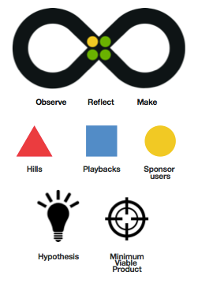
IBM Design Thinking
Scales design thinking to complex distributed projects
Helps cross-functional team deliver the experience, not just design it
Establishes shared practices
Applied at the Bluemix Garage
Emphasizes elements of Lean Startup
Hypotheses & assumptions
Define Minimum Viable Product to reduce risk and cost by building the smallest possible solution needed to test your assumption
Notes:
MESSAGE: IBM has adopted design thinking and has added to it to make it scalable to large cross-discipline product development teams
Hills - focus on the the big problems and outcomes for users
Playbacks - align a cross-discipline team on what is being designed and developed to address the user’s pain points
Sponsor users - help us design experiences for real target users, rather than imagined needs

Slide 16
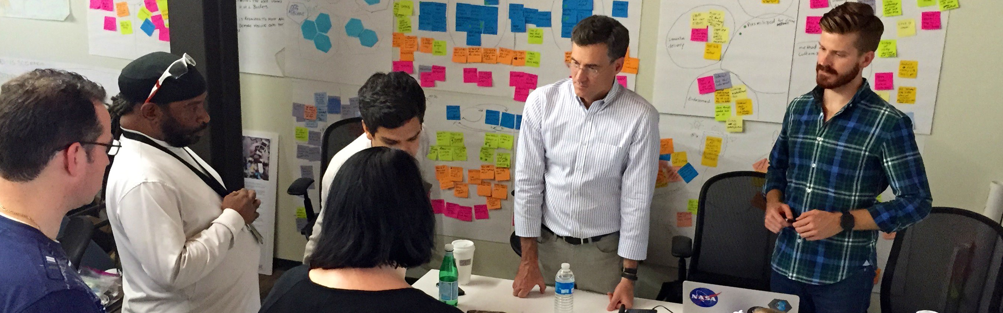
Code
Daily Standup
Small Batch
Automated Test
Continuous Integration
Generation, enhancement, optimization and testing of features
Notes:
IBM’s practical method combines the best of open communities, Design Thinking, Lean Startup, with an agile DevOps methodology. An open and repeatable method with best practices, tool chains and a thriving ecosystem. Provides:
Hardened method-ware, delivered as digital experience and practice library of work-product assets.
Accelerators to speed adoption, combining tool chains and methods.
Shared learning (videos, case studies, blogs) of IBM transformation; extends to clients, phase 2.
Open community forum to engage, comment, progress and extend methodology.

Slide 17
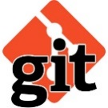
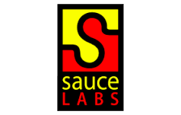

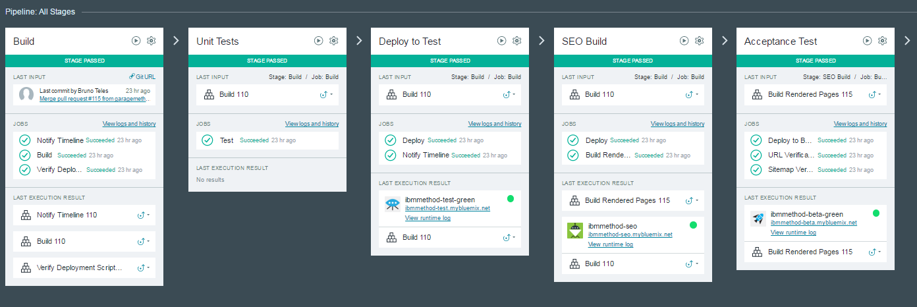
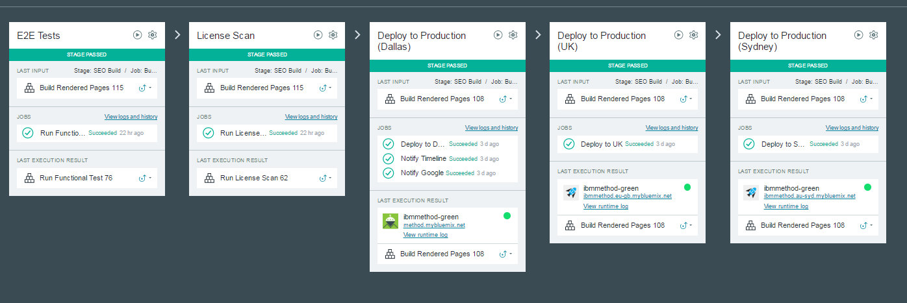
Deliver
Continuous Delivery
Automated production and delivery of offerings
Router
Router
Blue/Green deploy
Blue/Green deploy
IDS Pipeline: Automated build, test, and deployment to 3 Production Datacenters in 30 minutes
Notes:
Link to pipeline (requires auth):
https://hub.jazz.net/pipeline/methodadmin/ibmmethod-ci

Slide 18
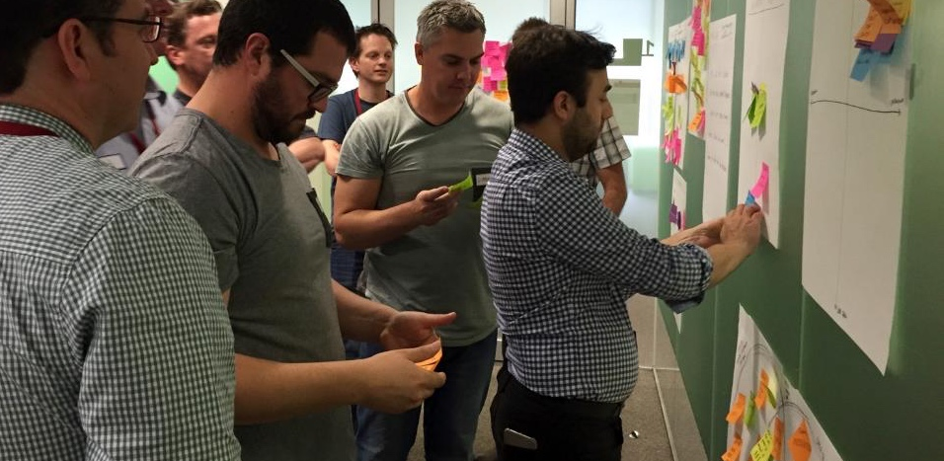
Run: How fast do you want to take your clients to the cloud?
From idea to production MVP in 4-10 weeks on Bluemix

Slide 19







High Availability
Active-Active Instance in each DC
Active-Standby across Regions
Run
SLA: 99.999% availability with <5s rsp times
ibm.com/devops/method
Services, options, and capabilities required to run offerings
Failover
Backup
Backup
Primary
CF App
4 instances
CF App
4 instances
CF App
4 instances
NodeJS
NodeJS
NodeJS
London DC
Syndey DC
Dallas DC
Bluemix UK-GB
Bluemix Australia
Bluemix US-South
Notes:
IBM’s practical method combines the best of open communities, Design Thinking, Lean Startup, with an agile DevOps methodology. An open and repeatable method with best practices, tool chains and a thriving ecosystem. Provides:
Hardened method-ware, delivered as digital experience and practice library of work-product assets.
Accelerators to speed adoption, combining tool chains and methods.
Shared learning (videos, case studies, blogs) of IBM transformation; extends to clients, phase 2.
Open community forum to engage, comment, progress and extend methodology.

Slide 20
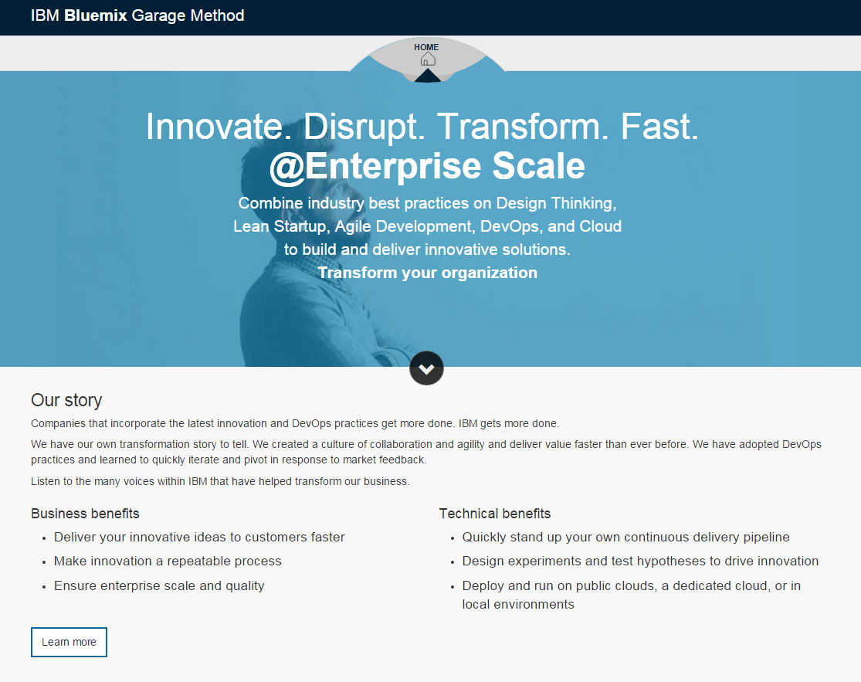
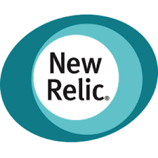

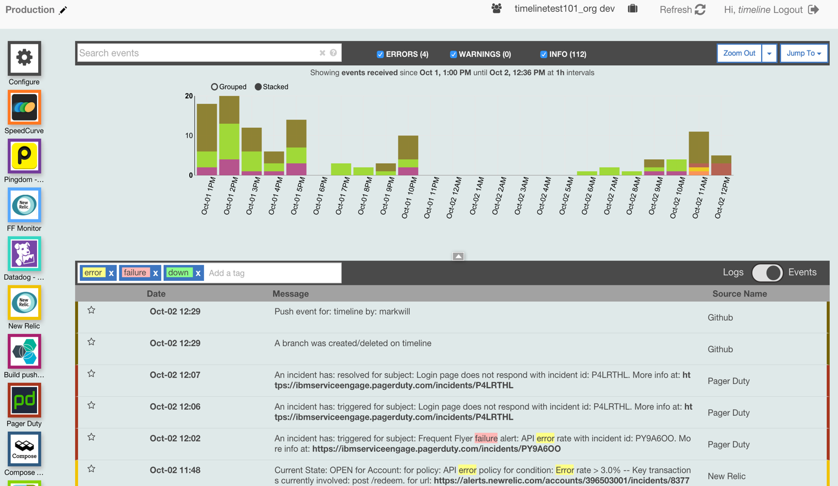




Monitors:
IBM URL
Dallas
London
Sydney
Manage
Synthetics
Monitors availability from 9 locations around the world.
Ongoing monitoring, support, and recovery of offerings
Incident
timeline
collaborate
Page, SMS
On Call Engineer
Escalation
Operations Manager
Notes:
IBM’s practical method combines the best of open communities, Design Thinking, Lean Startup, with an agile DevOps methodology. An open and repeatable method with best practices, tool chains and a thriving ecosystem. Provides:
Hardened method-ware, delivered as digital experience and practice library of work-product assets.
Accelerators to speed adoption, combining tool chains and methods.
Shared learning (videos, case studies, blogs) of IBM transformation; extends to clients, phase 2.
Open community forum to engage, comment, progress and extend methodology.

Slide 21
Hypothesis Driven Development
(compare versions of an app/site)
A/B Testing
Learn
Continuously learn based on outcomes from experiments
https://www.ibm.com/devops/method/category/learn
Notes:
Gather feedback and use it to drive your development process. Based on your findings, you might stay on course or pivot to ensure that you’re always providing value.
Learn from your customers
Formulate hypotheses and design experiments to drive development
Establish clear metrics for decision making
Drive findings to the backlog and pivot
Why change?
Developing applications and delivering them continuously allows teams to get new features into production fast. It also allows the team to obtain immediate feedback on the new features as soon as they are available. It makes sense to use that feedback to understand what the users find most and least valuable about the application in production. Feedback can either be provided directly by users or obtained through the analysis of usage data viewed using analytics tools. By making use of the data, the team can ensure they are building the functionality that the application users need most and are addressing areas that the users either dislike or don’t use.
What does the team do that is new?
Once the initial MVP of the project has been delivered, the team begins using Hypothesis Driven Development to ensure that they continue to build what the customer wants next. In order to do this the team stops writing requirements and moves forward by forming hypotheses and setting out to prove or disprove them. The difference can be seen in how these are written. Agile stories generally follow the format: As a <role>, I want <some function> so that <benefit>. A hypothesis follows the form: We believe that <function> will lead to <outcome> and this will be proven when <measurable condition>. For example: We believe that <adding links to related webpages> will lead to <users going deeper into the site content> and will be proven when <we see an increase in the page views for the pages that are linked>. Hypotheses are written and stored in the backlog as work items for the development team. They are integrated into the backlog and prioritized with all other work the team does. Some hypotheses require the team to determine which of multiple versions of a solution is most appealing. A/B Testing can be used to compare how application users react to two different versions that provide the same functionality. At the end of the test period, you can use empirical data to ensure that you pick the implementation that the users like best.
When the team implements Hypothesis driven development, they must be able to:
formulate hypotheses based on usage data
measure the results of the hypotheses based on usage data.
Based on measuring the results of the experiments, the hypotheses are either proven, disproved, or abandoned. It is critical that the team decide how long it will take to gather data to either prove or disprove a specific hypothesis. The length of time required to measure results depends on the function that has been delivered and differs for every hypothesis. Generally, the team does as little work as possible to either prove or disprove a hypothesis. Sometimes the result of the experiment creates additional work for the team. This work is captured in user stories and added to the Ranked list backlog. Other times, the team learns they were headed in the wrong direction. When this occurs the team shifts direction, or pivots.
Communications is key
Analytics dashboards can be shared across the team so everyone can see customer usage data and participate in the formulation of hypotheses.

Slide 22
Why the Method works
Focus and outcome driven by client, guided by diverse IBM expertise
1
Whole Team Culture
All key client stakeholders and Garage team members are on the same page with the same goal
2
Fail fast with validated learning
Validating user experience and testing hypotheses to keep client constantly on track
3
Embedded UX design
Collaboration with designers and architects is organic, ensuring an experience that will engage users
4
Meaningful MVP outcome
MVP product outcome reflects progress from Garage experience, a legitimate starting point for further iteration
5
Platform analytics for easy scaling
IBM Bluemix enables auto-scaling, monitoring, and operations management
An end-to-end process that includes cloud readiness, design, enablement, development, technology, and scaling is an IBM Bluemix Garage exclusive.

Slide 23



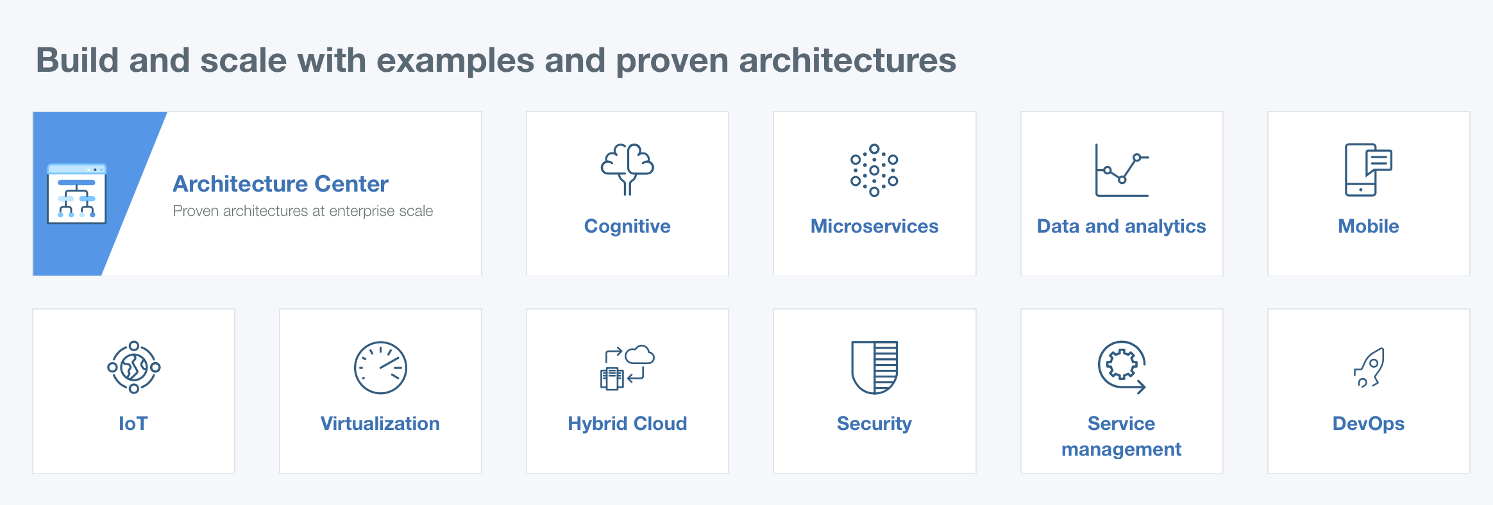
IBM Cloud Garage Method
Enterprise Apps
Built by teams
Using Devops Practices & Toolchains
Putting it all together
What type of app do you want to build?
Practices
Application Architecture
Runtime & Technology Choices
Sample Code
Toolchains
How should you build it?
Architectures
DevOps Practices
DevOps Toolchains
DevOps (toolchain) Architecture
Learn new technologies

Slide 24
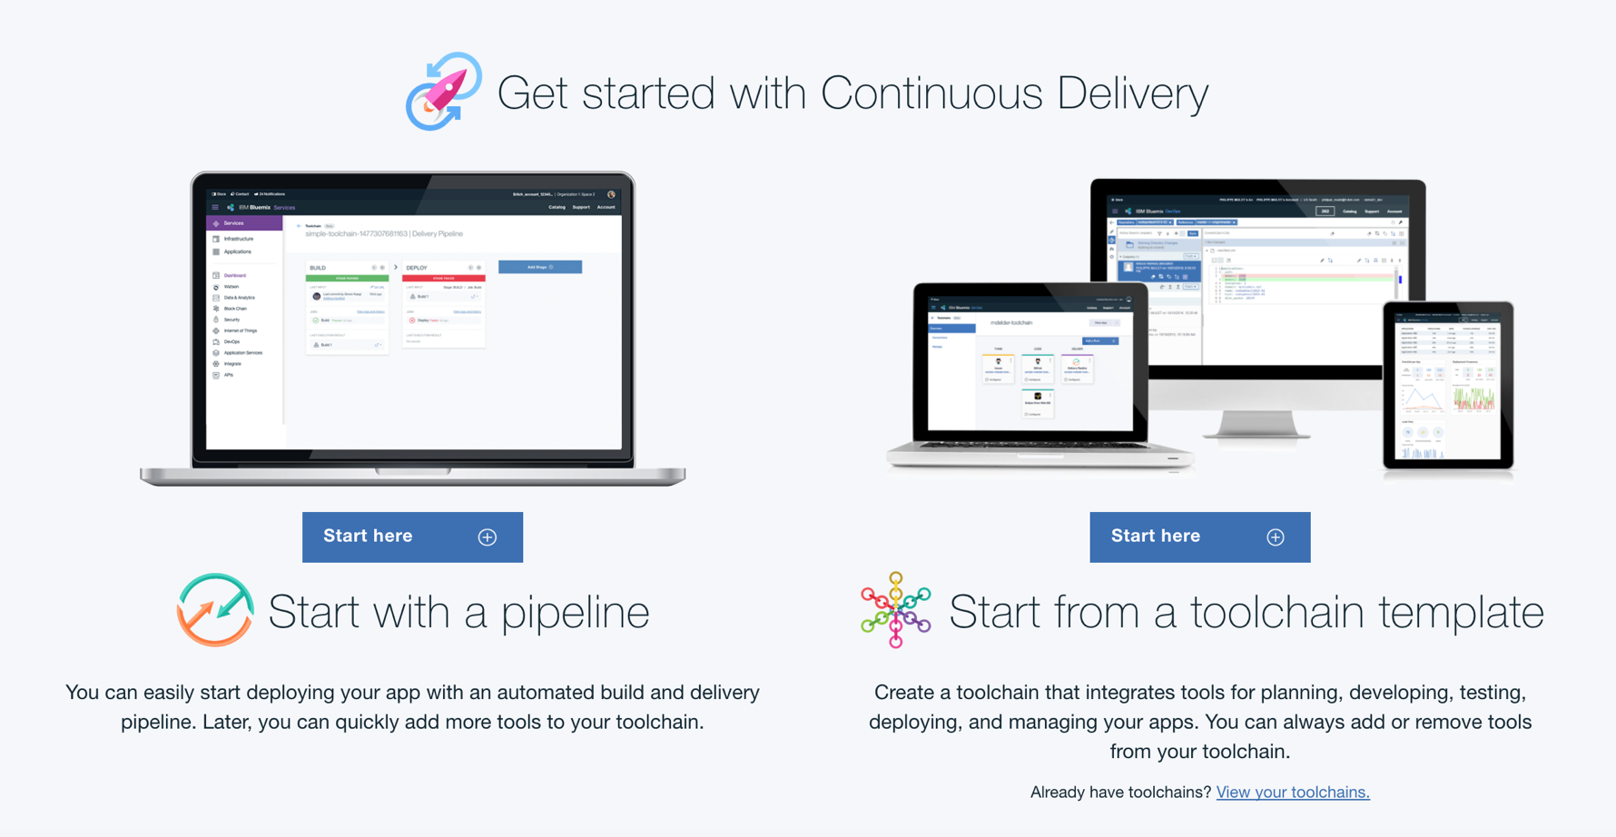




Introducing IBM Bluemix Continuous Delivery
Speed with control
Create an integrated DevOps toolchain
Deliver continuously using an automated pipeline
Improve quality through insights
Edit your code from anywhere
To learn more visit:
https://bluemix.net/devops/

Slide 25
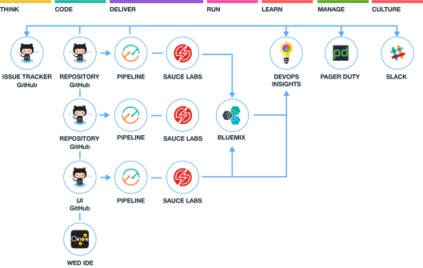

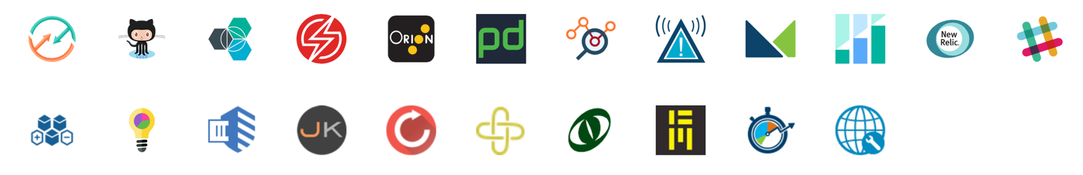
Help along the way: Choosing the right tools that excel at supporting new practices & technologies is a key step.
Open Toolchains
Aligned: Toolchains provide an integrated set of tools that support the Garage Method practices.
Easy: Rapidly instantiate new toolchains from templates to on-board new teams quickly.
Open: You can create toolchains that include Bluemix services, open source tools, and third-party tools.

Slide 26
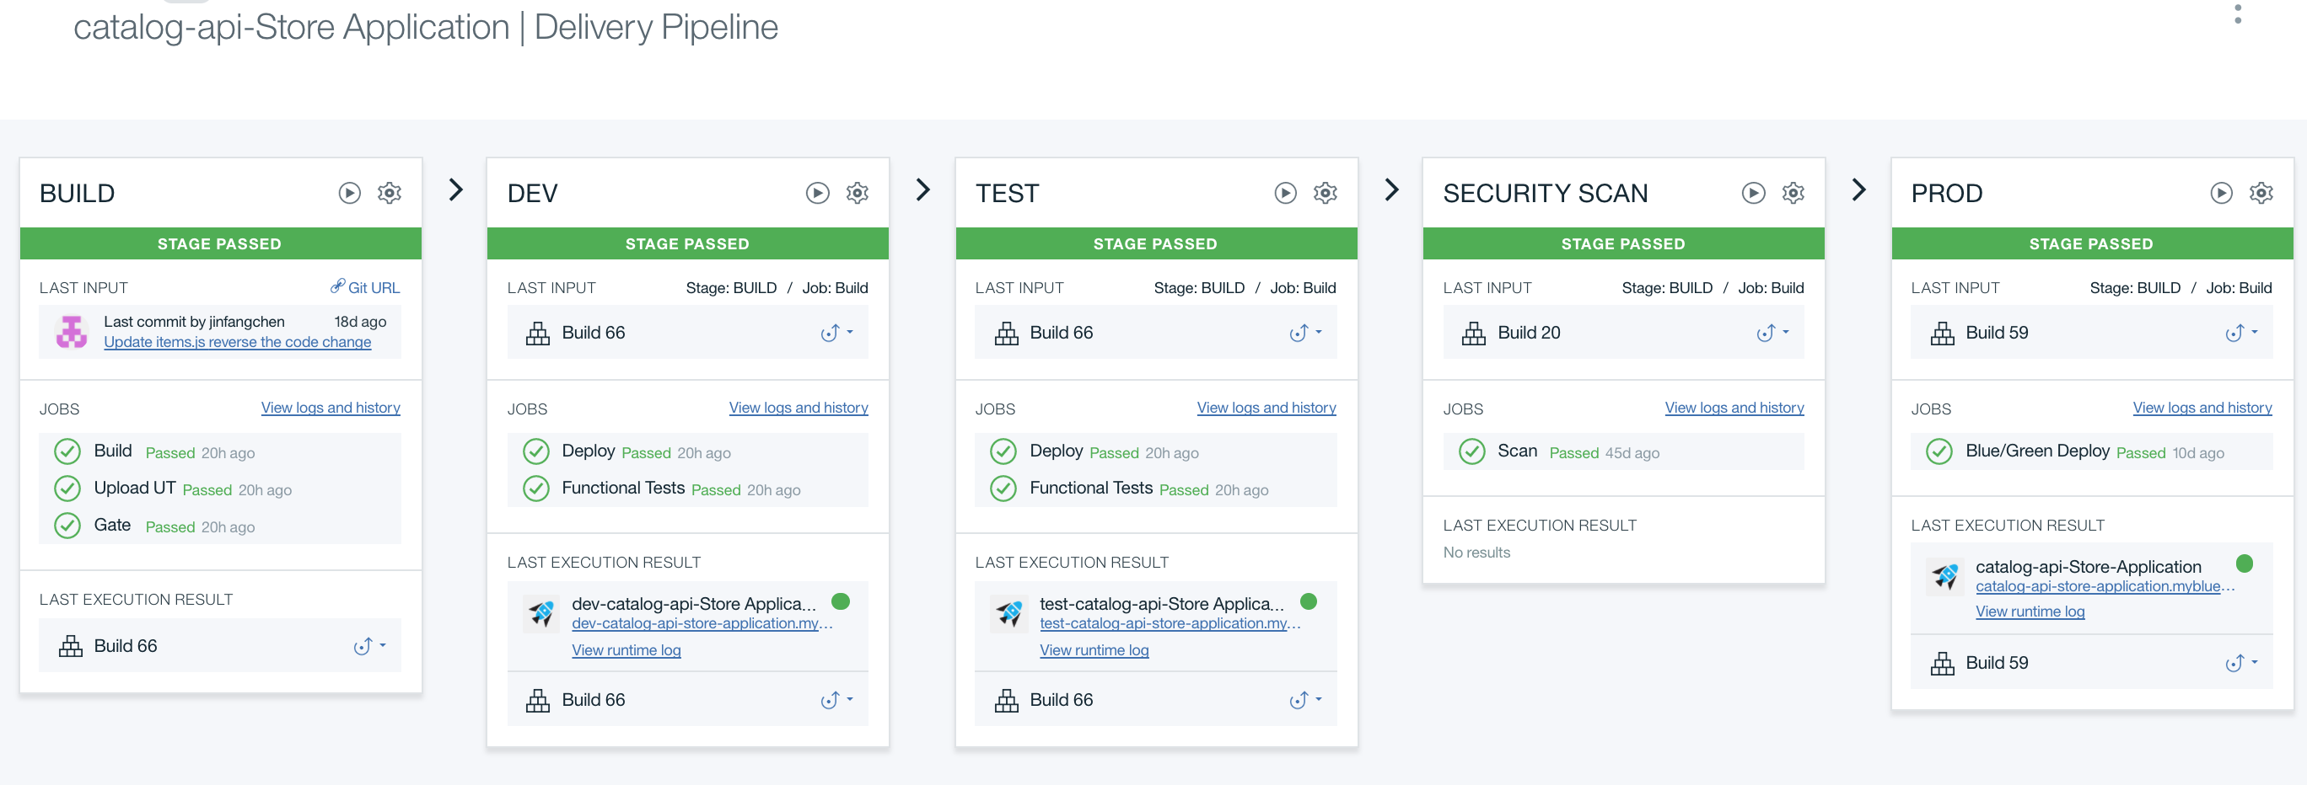
Deliver continuously using an integrated pipeline
Import Code
Import, build, and deploy an application from a GitHub or Jazz repository in a few clicks.
Continuous Integration
Automate builds and deployments for many types of code, running builds automatically when code changes.
Continuous Testing
Integrate automated unit tests as part of your builds.
Deliver to Multiple Cloud Platforms
Deploy applications to one or many Cloud Foundry or IBM Containers on Bluemix environments.

Slide 27
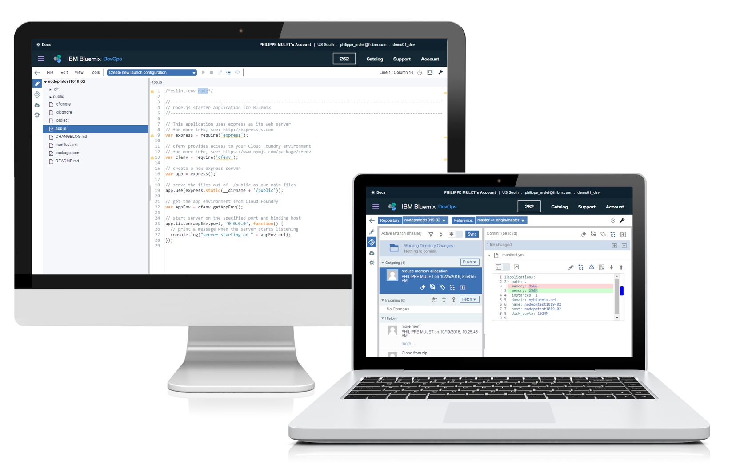
Edit your code from anywhere
You can choose to use the integrated, web-based environment built on Eclipse Orion.
Create, edit, run, debug and complete source control tasks, and seamlessly move from editing your code to deploying it to production.

Slide 28
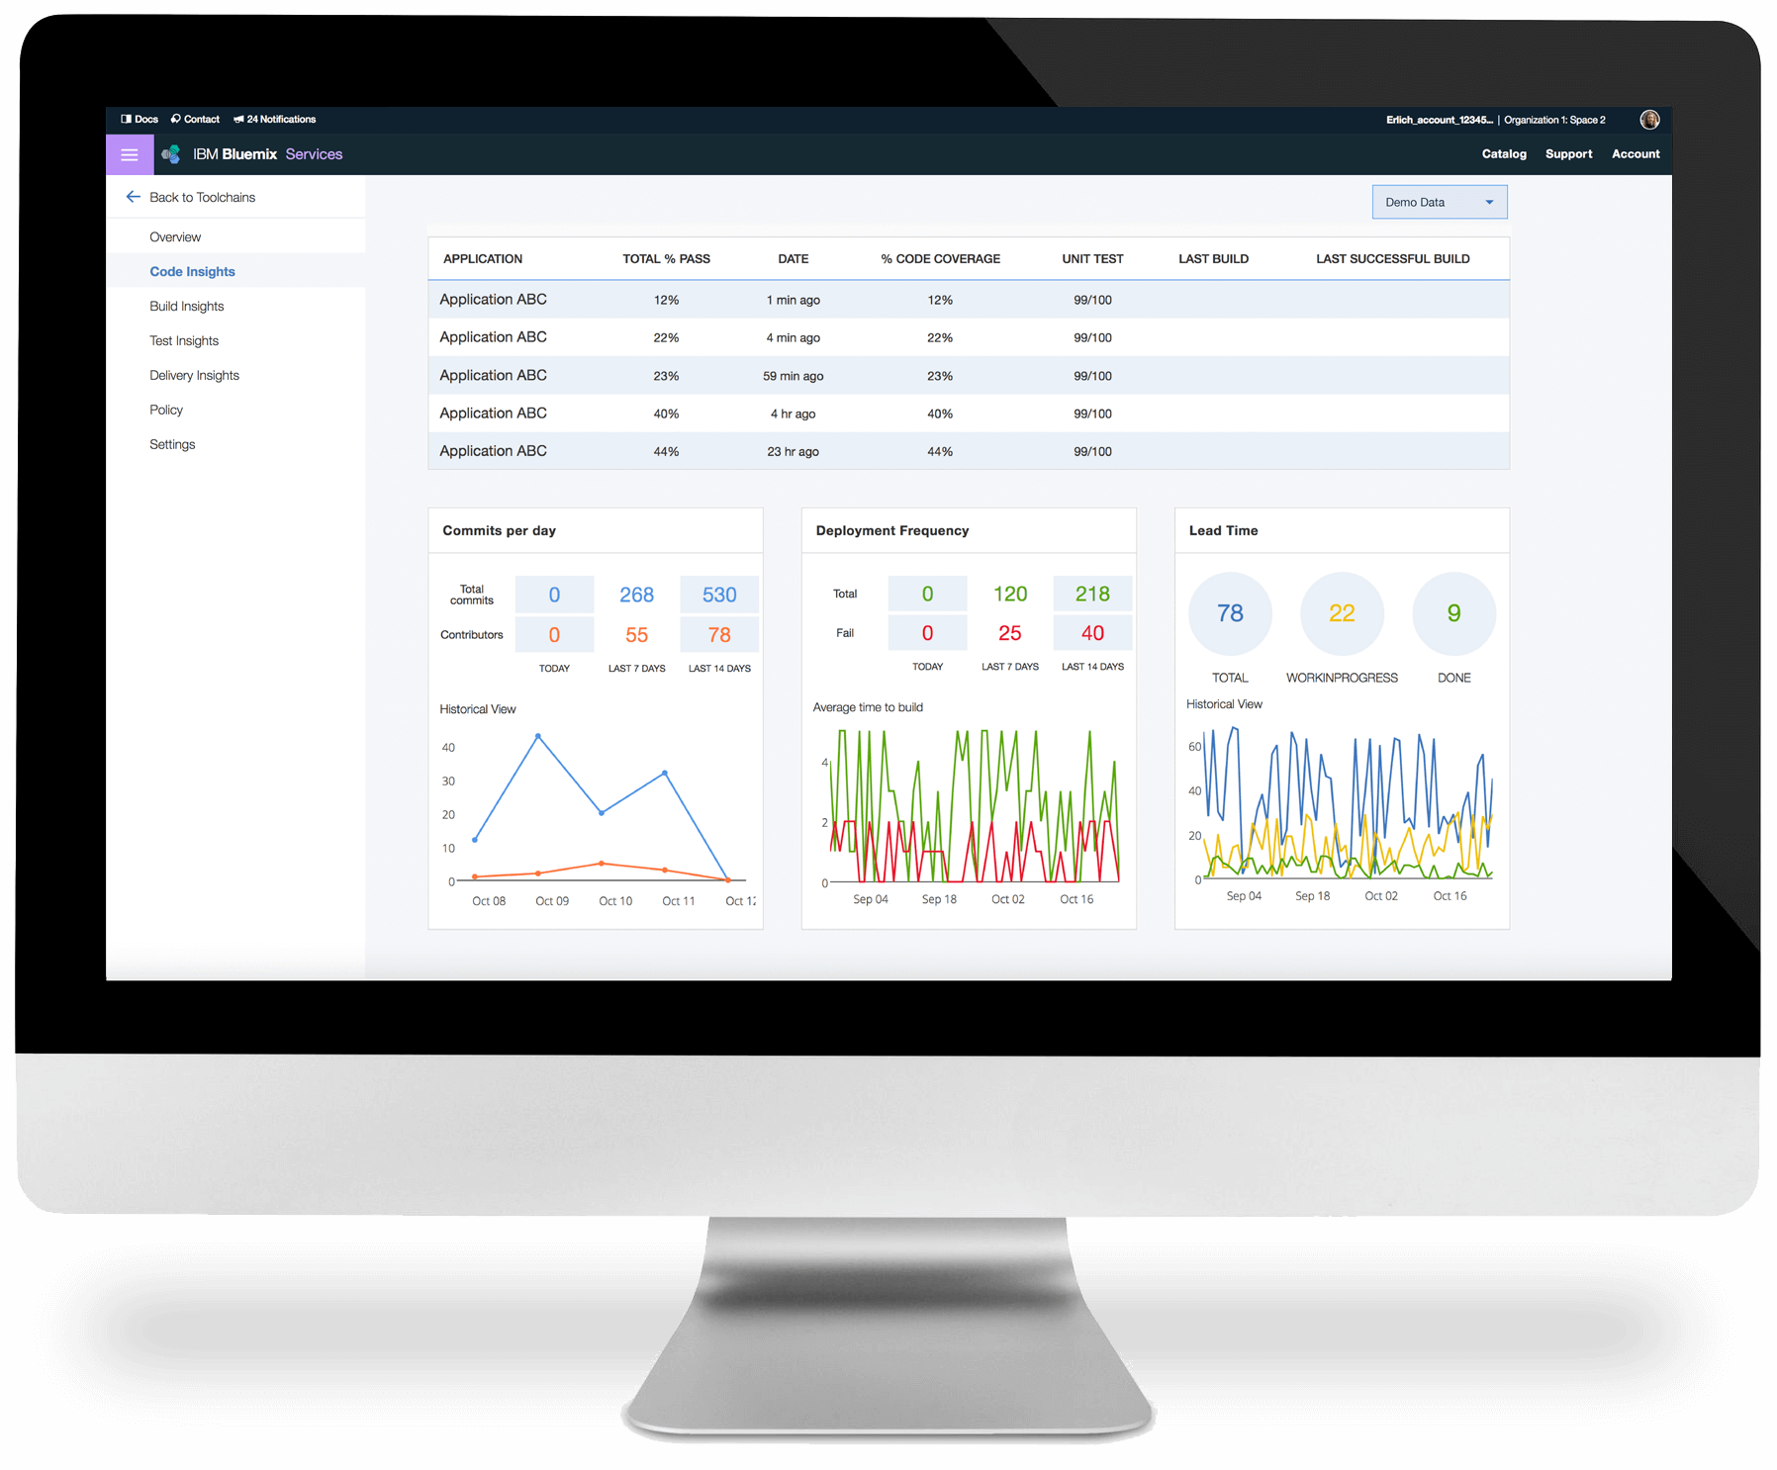
Improve quality through insights
Understand the team dynamics as they develop and deliver code.
Evaluate code quality – including code coverage, unit test, function test and security scan results.
Understand delivery metrics and lead times.

Slide 29
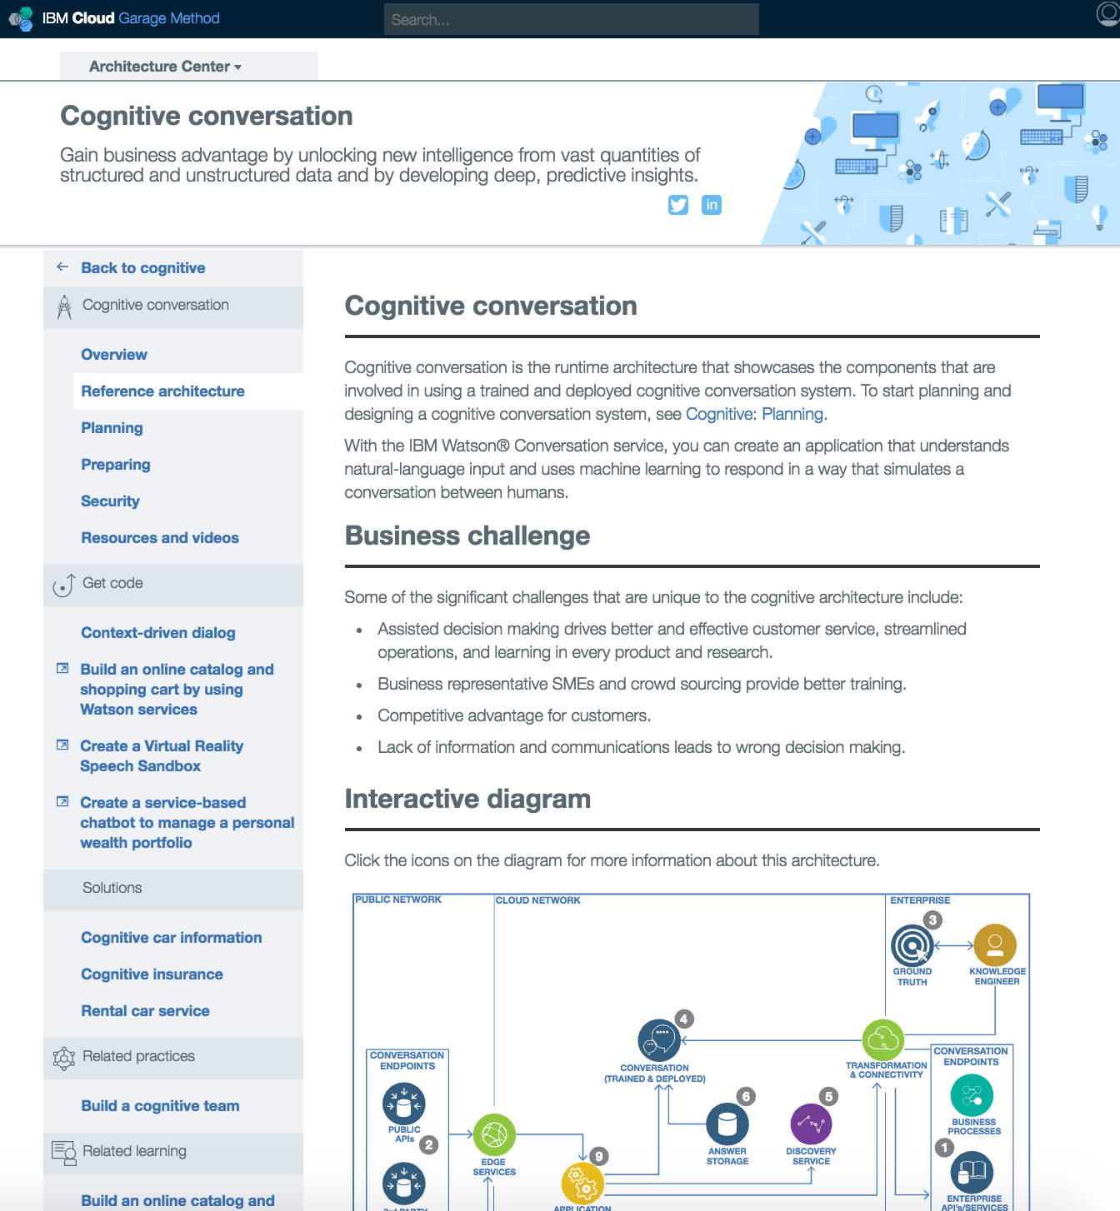
Build and scale with examples & proven architectures
IBM's architectures provide the best practices for building applications in the Cloud. The reference architectures define the basic pattern, while implementations provide specific technology, practices, and tool choices to build and deploy that pattern.
https://www.ibm.com/devops/method/category/architectures

Slide 30
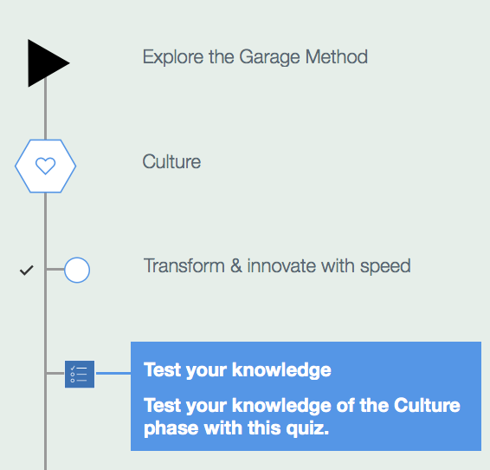
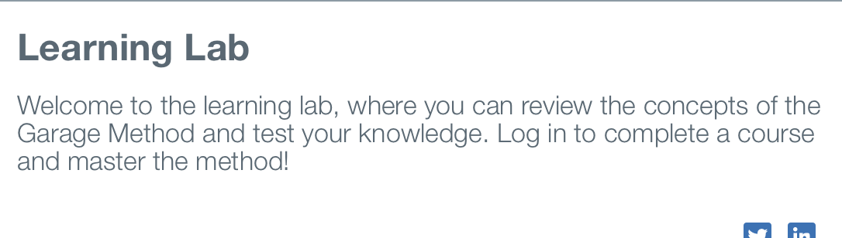
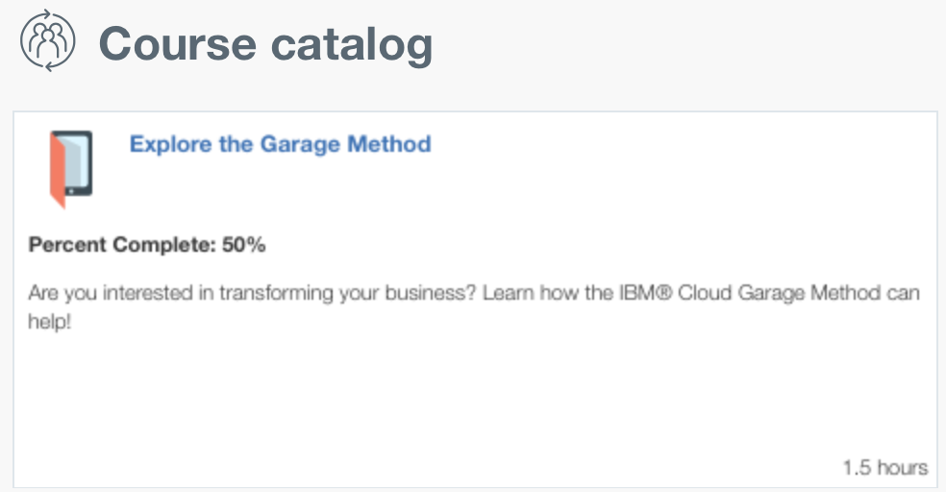
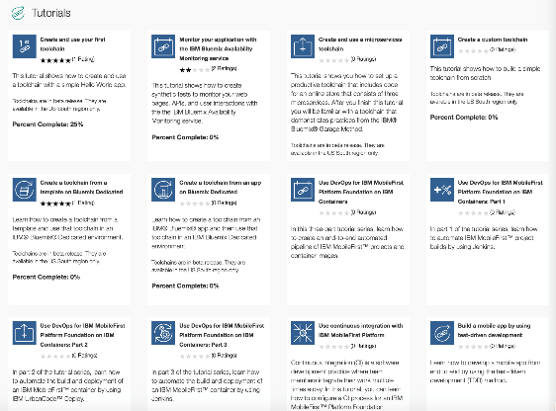
Learning Lab
Garage Method courseware provides development teams with a way to extend the team knowledge.
Courses provide experience with the practices, tools, architectures and platforms to transform everything from your team to your enterprise.
Personalized results, analytics and team metrics
New courses and tutorials being added constantly. Check your progress!
https://www.ibm.com/devops/method/category/courses

Slide 31
For more information
Cloud Garage Method:
Main page: https://www.ibm.com/devops/method
Practices: https://www.ibm.com/devops/method/category/practices
Architectures: https://www.ibm.com/devops/method/category/architectures
Toolchains: https://www.ibm.com/devops/method/category/tools
Learning Lab: https://www.ibm.com/devops/method/category/courses
Bluemix Garage Services:
Main Page: https://www.ibm.com/cloud-computing/bluemix/garage
Bluemix Continuous Delivery:
Get started with Bluemix Continuous Delivery: https://console.ng.bluemix.net/devops

Slide 32
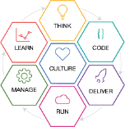







DevOps accelerates digital transformation with standardization and automation
Innovate faster by accelerating software delivery across hybrid environments
Improve customer engagement by shortening feedback loops
Create a culture of continuous improvement and trust
Eliminate error-prone manual steps and speed up the release process
Deliver new products/services quickly, improve customer experience
Transformed from 18-month cycle times to delivering a complete mobile solution in just five months—with 3-week update cycles
Generated 1,000 items of feedback on new mobile app in 2 weeks. Reduced implementation time by 90-95%
Reduced critical defects by 80% over the last three years. 90% on-time delivery versus 60% previously
Reduced time required for software releases by 99%. Cost avoidance of more than US$2.3M per year for one app.
ROI of AU$4.27 million from cost savings & efficiency improvements within the first year. Reduce deployment times: 3 days to 15 minutes.
Notes:
Main point:
DevOps accelerates digital transformation and enables enterprises to deliver at speed, respond and speed and transform at speed.
Primerica video @ 1:15:20 https://www.youtube.com/watch?feature=player_detailpage&v=g7JZgAI3IDI
Primerica's 100,000 member sales force serves the needs of the vast middle market across North America. They sought a mobile technology solution to support two mission-critical events happening every day in the company: the needs-based sales process - a high-touch event occurring face-to-face in the client’s home at the kitchen table - and the onboarding, engagement and retention of new representatives joining the company. To address the challenge, we created a unified, cross-platform mobile web / app solution that allows Primerica Reps to access the tools they need, online and offline, on any device. The information they care about is automatically delivered at just the right time without them having to search for it.
With our new interactive and mobile-friendly solutions and enhanced onboarding process, Primerica Reps can provide key information to the client in under 5 minutes, and new Reps can get off to a fast start. Tom Swift , EVP Field Technology - Primerica
Leverage a DevOps approach to deliver a set of key mobile business apps to a workforce of 100,000 financial services representatives in just five months from concept to delivery -- and now updating on a 3-week cycle time.
Tangerine video: https://www.youtube.com/watch?v=Q3Umh-F5_6w
Tangerine Bank embraces “MobileFirst in a box” solution featuring IBM Mobile Quality Assurance on Bluemix
Benefits:
Further differentiate their market leading position in mobile banking
Reduce end-to-end development time from 6 to 2 weeks
Stand up an operational hardware and software stack in 30 minutes
Key accomplishments:
Deploy and run mobile applications based on customer insights
Proactively monitors site and mobile processes to resolve usage issues faster
Speeds response times to feedback to increase customer satisfaction
Solution components:
IBM Bluemix DevOps Services (Mobile Quality Assurance)
IBM Worklight with IBM API management with DP XG45 (security gateway),
IBM Tealeaf,
IBM PureApplication System
Quote:
“IBM BlueMix Mobile Quality Assurance allows Tangerine to provide a proactive customer experience that is relevant and contextual. A ‘shake to feedback’ feature is embedded in our mobile app, allowing customers to provide direct feedback about our mobile features and giving us insight into their mobile experience. We will continue to leverage IBM BlueMix and Watson to further engage our customers and deliver innovative mobile solutions based on their direct input. - Charaka Kithulegoda, CIO, Tangerine
Nationwide video: https://www.youtube.com/watch?v=_uprgTAMA_Q
Nationwide
Overview
Over the past 80 years, Nationwide Mutual Insurance Co. has grown from a small mutual auto insurer owned by policyholders into one of the world’s largest insurance and financial services companies, with more than USD135 billion in statutory assets.
Business need Nationwide needed to better respond to changing market requirements and regulations, increase speed to market for new products and services, and support new channels of customer interaction.
Solution Nationwide engaged IBM to support its agile transformation and help enable an DevOps approach to application development and delivery across its distributed and mainframe environments.
Benefits Nationwide improved code quality by 50 percent over a 3-year period (80% reduction in critical defects. 86% reduction in “high” defects), reduced user downtime by 70 percent and moved 58 percent of its teams to the top quartile in key productivity measures, with 82% of agile teams in the top two industry quartiles (QSM). Today, Nationwide has 90% on-time delivery vs. 60% previously.
Software:
Rational Application Developer, Rational Asset Analyzer, Rational DOORS Next Generation, Rational Development and Test Environment for System z, Rational Team Concert
Fidelity Worldwide Investment:
Case Study: http://www.ibm.com/ibm/devops/us/en/casestudies/fidelity.html
Overview
Fidelity Worldwide Investment is a leading international provider of investment products and services. In addition to its well-known fund supermarket, FundsNetwork, Fidelity Worldwide Investment also provides retirement products, including Direct Contribution pensions, and employee workplace savings.
Business need As it prepared to launch a critical new application, Fidelity Worldwide Investment wanted to replace its manual release processes with an automated release solution.
Solution The organization used IBM UrbanCode Deploy software to create a software release automation framework, eliminating error-prone manual steps and speeding up the release process.
Benefits The solution helped reduce the time required for software releases by 99 percent, from 2 - 3 days to just 1 - 2 hours. The company also achieved cost avoidance of more than USD2.3 million per year.
ANZ Bank:
IBM solutions for automated deployment of application changes allowed teams to reduce deployment times of components from 3 days to 15 minutes.
Environment management improvements enabled ANZ to achieve an ROI of AUD4.27 million from cost savings and efficiency improvements within the first year.
Powered by IBM Bluemix, the ANZ Innovation Lab allows the bank to increase productivity, to deliver new products and services to market quickly and improve the customer experience
Links:
Press release: https://www-03.ibm.com/press/us/en/pressrelease/47580.wss
Case Study: https://www-01.ibm.com/marketing/iwm/iwm/web/signup.do?source=swg-AU_WEB-ORG_Rational&S_PKG=ANZ_Bank_Case_Study&S_TACT=109HG0LW&lang=en_AU
32

Slide 33
"There was a 40% improvement in development time. That translates into financial savings, and also makes this a new opportunity, because it probably wouldn't be possible if it were going to cost more."
Nigel Hook President, SilverHook Powerboats
"Bluemix [is] the core of our innovation platform so that we can rapidly deploy and test applications both with our partners and with our consumers to deliver the best innovation experience possible."
Charlie Larkin Senior Director, GameStop Technology Institute
"Bluemix and SoftLayer transformed our business and have given new levels of power to our customers."
Neil Mulkern Business Development Director, Pay Per Pulse Ltd.
"By integrating with Bluemix and SoftLayer, we can cut development times significantly, and we no longer need to care about issues like scaling."
Robin Hrassnigg CEO, Diabetizer

Slide 34
Backup

Slide 35
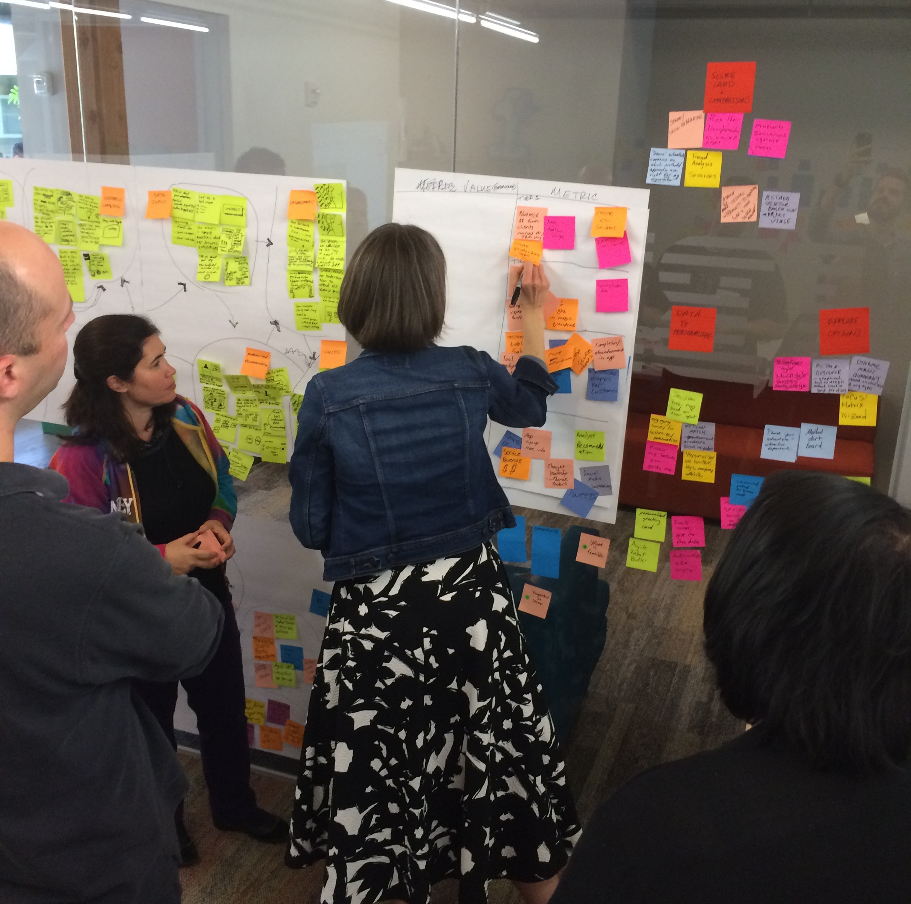
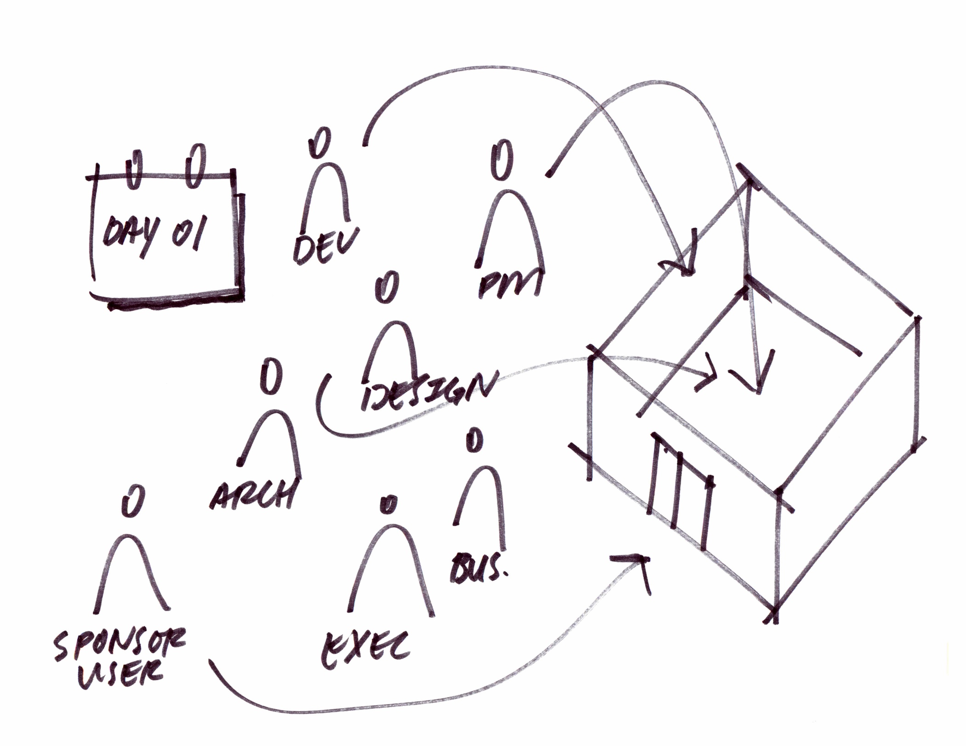
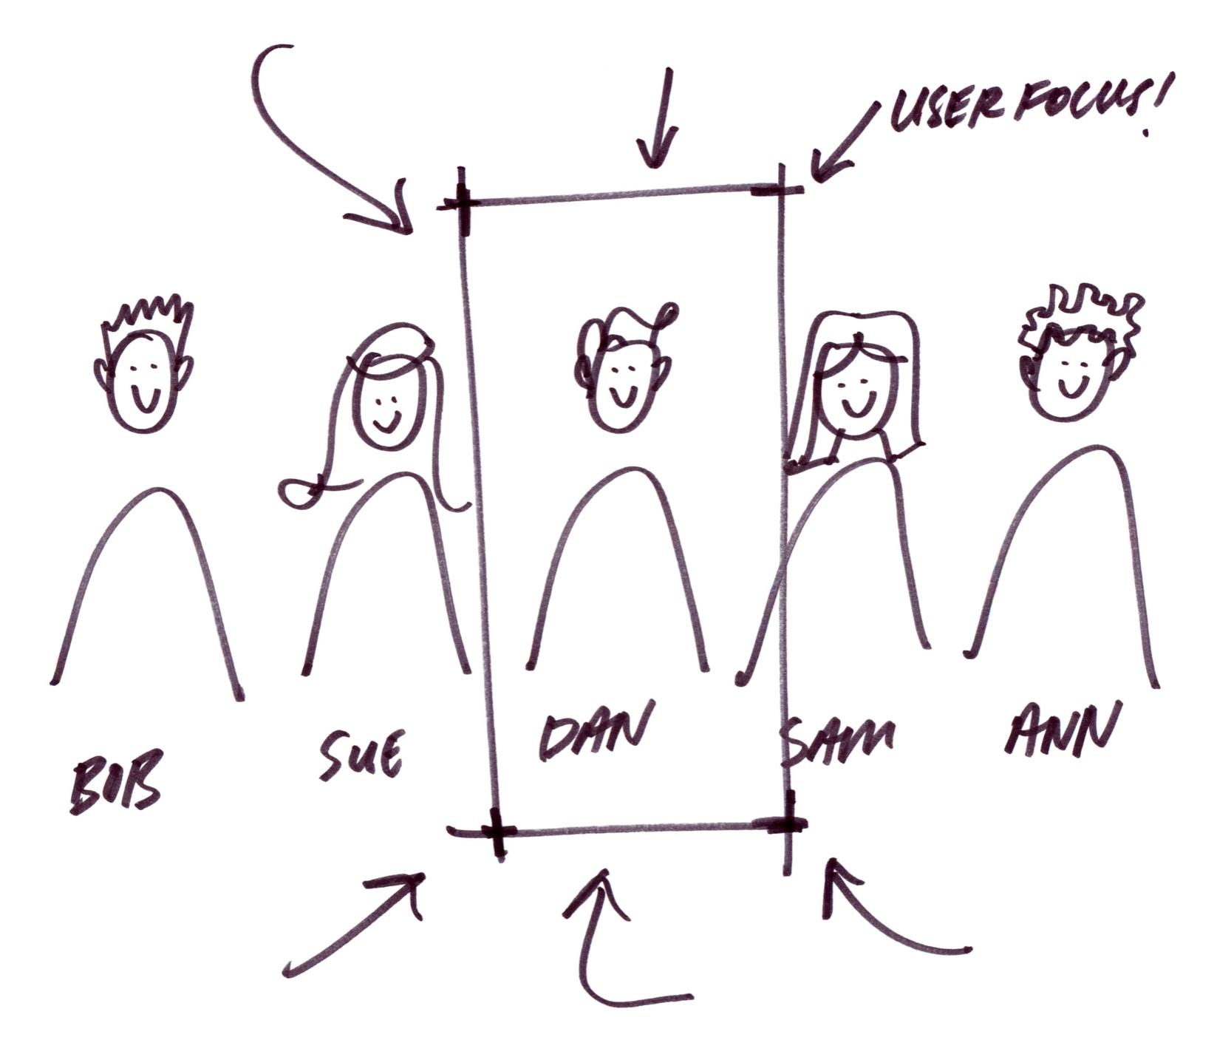
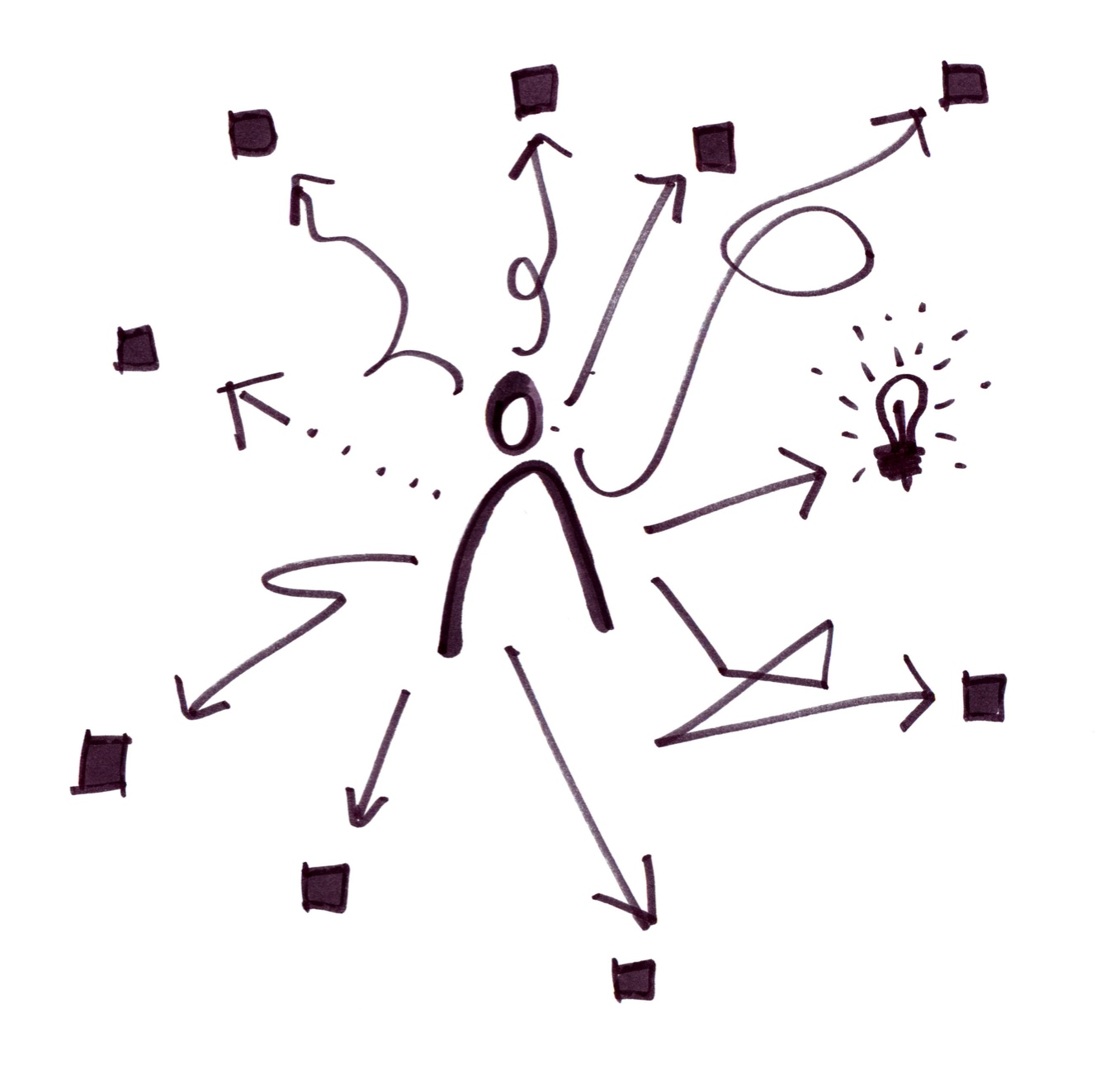
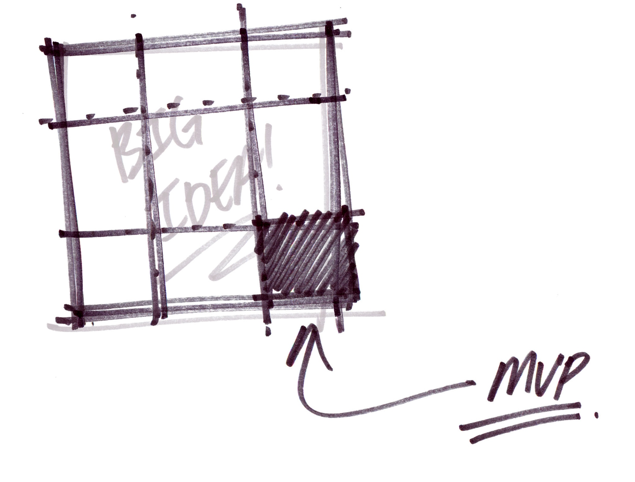
A visit to the Garage

Slide 36







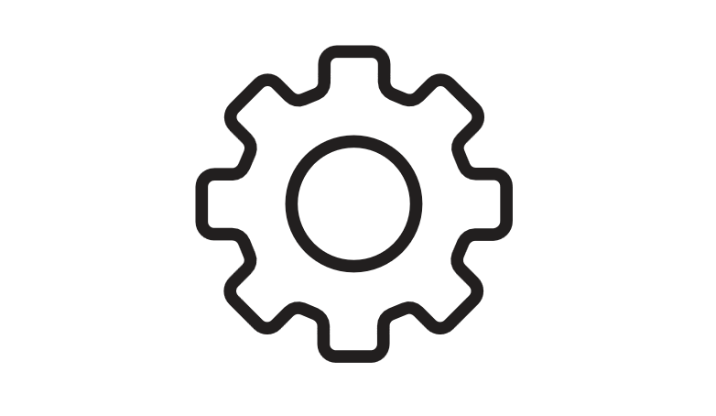

It starts with an Idea!
Navigating through the Garage Method Practices
Empathy Maps
Hypotheses Driven Development
Personas
Scenarios
Wireframes
Prototypes
Sponsor Users
A/B testing
Get to know your target audience
Define and Design your MVP
Autonomous Squads
Test Driven Development
Analytics
to drive business decisions
Behavior Driven Development
Pair Programming
Culture of Learning
Code
Using Self-directed Squads with Rank Ordered Backlog
Chaotic Testing
Operations automation
Multiple Stages
High Availability and Resiliency
Red Black Deployment
Automated Delivery
Daily Builds
Monitoring
Unattended Test automation
Small Batches
Leverage the power of the cloud
Dark Launch and feature toggles
Deliver
Continuously
Manage
Ensure Operational Excellence
Run
Production Systems

Slide 37
www.ibm.com/devops/method
IBM Cloud Garage Method is IBM's approach to rapidly deliver engaging applications.
It combines Design Thinking, Lean, DevOps, and Agile practices –
With proven reference architectures & toolchains –
That focus on the cloud, but can benefit any software development effort.
Deliver the right outcomes at the speed the market demands

Slide 38
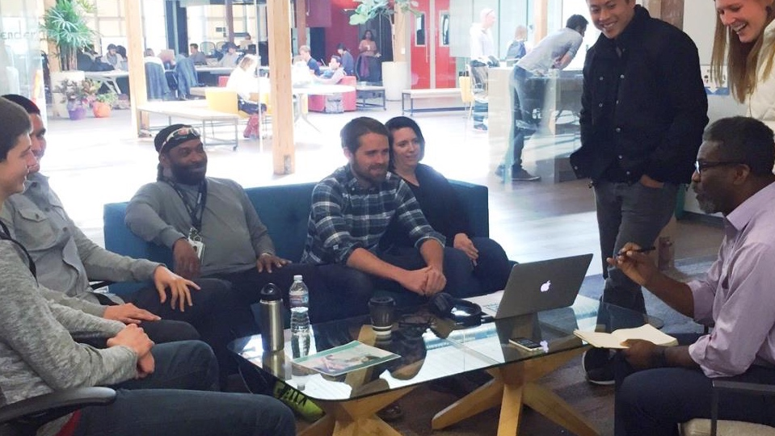
Leading clients—of all sizes—to build ‘the right apps’ on IBM Bluemix through IBM Design Thinking, Lean Startup, Agile and devOps.

Slide 39
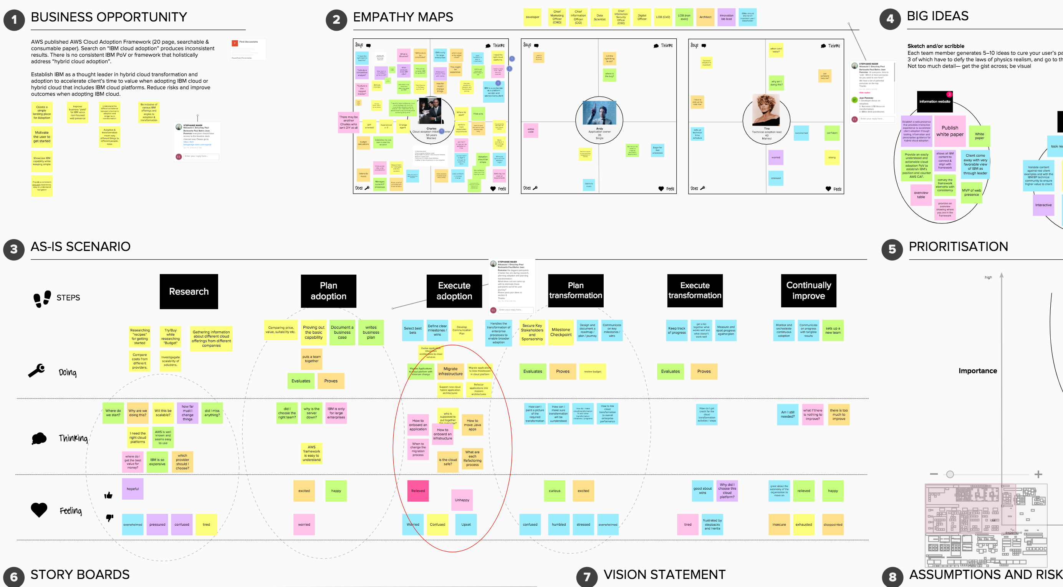
Notes:
https://app.mural.ly/t/cloudgottalent0342/m/cloudgottalent0342/1481295788841

Slide 40

Culture
“
In everything we all do, its all about working in an agile way… envisioning an outcome, prototyping, iterating, multidisciplinary teams… we do that in many parts of IBM today, but we’re scaling it at an enterprise level.”
GINNI ROMETTY

Slide 41

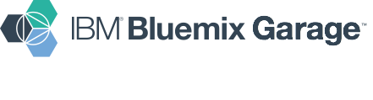

Example of successful large-scale, multi-speed IBM project
Chris Lazzaro Lead Architect, Bluemix Garage Method clazzaro@us.ibm.com

Slide 42

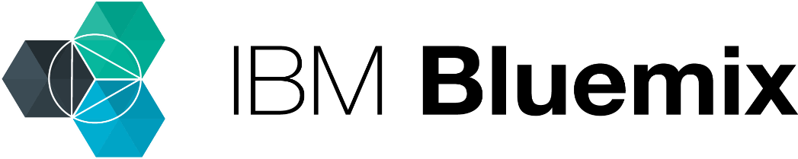

Hybrid Cloud Management
Frequent Flyer Mobile Application
PaaS
WebSphere
Business Logic
Cloud
Flyers’ Information
On-prem
Client Details
IBM Bluemix Garage | 2016 Confidential

Slide 43
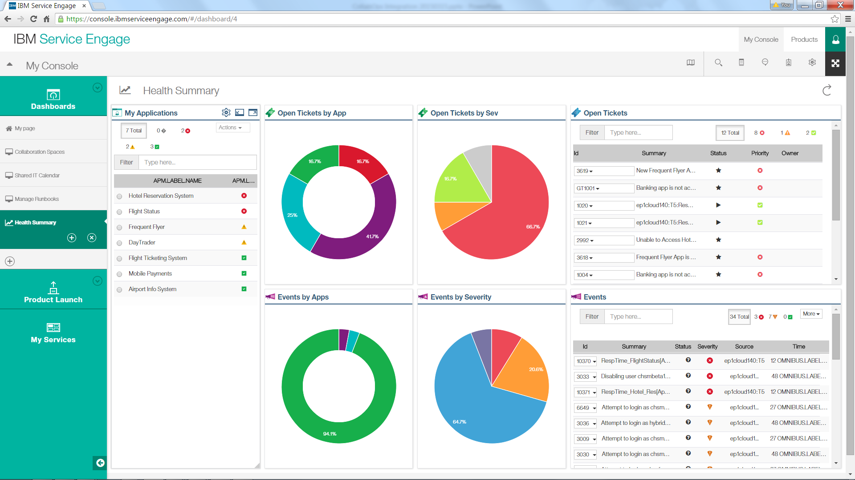

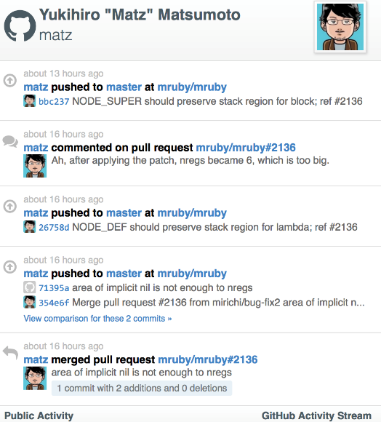
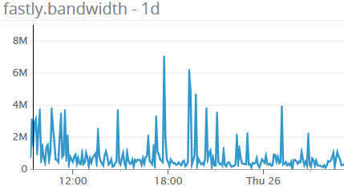
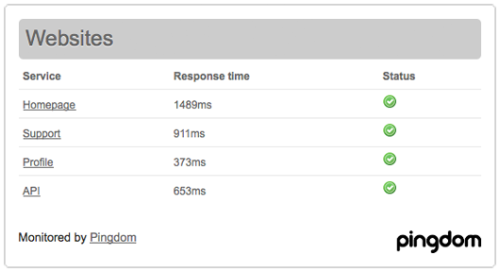
Dashboard views across all of your tools
Monitor - APM
Ticketing - Control Desk
3rd Party
Eventing - Omnibus

Slide 44


Collaborate to Solve Problems
Consolidated
App Ops &
Virtual War Room
Teamboard
Calendar
Virtual War Room
Resolve outages quickly by:
1 Collaborating with Subject Matter Experts using a shared Teamboard to see status, data, and ideas from your team.
2 Follow Best Practices defined in a Runbook to diagnose problems & run corrective action.
3 Calendar shows changes across your apps & env
Runbooks
SME Members
Virtual War Room
Customer
Application
4
Dashboards
Service Engage
Intelligent
Console
Notification
Bluemix
Application
Monitoring
Ticketing
Gateway Services
SoftLayer
3
Data
Internet
On Prem Enterprise
[ SWG EP Cloud ]
1
Alerts
Gateway Connector
APM
Agent
2
Tickets
Consolidated App Ops
The Customer’ Application is developed, deployed, and hosted in Bluemix & APMaaS monitors both the Bluemix & On Premise portions
1 Alerts from APMaaS are forwarded to the On Prem Omnibus
2 Omnibus correlates data and opens trouble tickets in SCCDaaS
3 Intelligent Console queries Omnibus via the Gateway Services
4 Intelligent Console shows Correlated dashboards from SaaS&OnPrem
Infrastructure
Monitoring
Events
Customer
Application
Discover & Track Problems

Slide 45



Accelerating Innovation
Production
Think
Code
Deliver
Run
Finding the balance between agility and stability
API Catalog
Systems of engagement
Digital Applications
“Forty-five percent of CIOs state they currently have a fast mode of operation, and we predict that 75 percent of IT organizations will be bi-modal in some way by 2017.”
- Gartner Research, Nov 10, 2014
Systems of Record
Enterprise Applications
Production
Plan
Dev/Test
Deploy
Operate
Notes:
http://www.gartner.com/newsroom/id/2903717
But even with optimized DevOps solutions to cater for these differences, the reality of a two speed IT makes the delivery of these integrated systems complicated multi-team projects.
Why do we talk about two speed?
- SoR teams typically release software in cycles measured in months, commonly 3-6 months with very distinct phases, dedicated teams (e.g. testing).
- SoE teams typically deliver new versions of their software in days or weeks.
These differences in speed, culture, and priorities create lots of challenges to manage dependencies. Typical issues include:
Lack of clarity on Services requirements
Mis-alignment of schedules and priorities
Different tools and infrastructures render rollout of entire stack complex
How do we solve this?

Slide 46


Cloud Enabled Pipeline Improvements
Services Build
Image Construction
CVT+SVT+IVT
Staging
Production
TWL
DASH
GW
Template
JazzSM
Template
JazzSM
Template
JazzSM
Template
NFS
Template
TCR
JazzSM
JazzSM
Template
AC
GW
NFS
AC
Template
VM
pool
NFS
VM
pool
NFS
VM
pool
NFS
GW
GW
GW
3 days
3-13 days
10 days
2 days
Total: 18-28 days
2-3 days
2-8 days
5 days
2 days
Improvements:
DASH BVT 100% Automated
TWL BVT 100% Automated
Total: 11-18 days
Improvements:
JazzSM Image creation reduced by 33%
AC/GW/NFS automated image construction. Saves 9 hrs of manual labor
Improvements:
CVT execution 70% automated overall.
DASH CVT 5d->7h
TWL CVT 7h-5h
SVT execution 100% automated.
DB2 Scan Automated
Aligned on CDTAF as a test framework
Improvements:
Remediation scripts created and integrated into the image build process.
Aligned deployment with security guidelines
Approximately 80 violations eliminated
Delivery Guidelines:
Scheduled maintenance windows every two weeks.
Updates must also be approved by the CAB prior to go Live
33% Reduction in image construction is result of adopting uDeploy.
<1-4 days
3 days
1 day
Total: 5-8 days

Slide 47
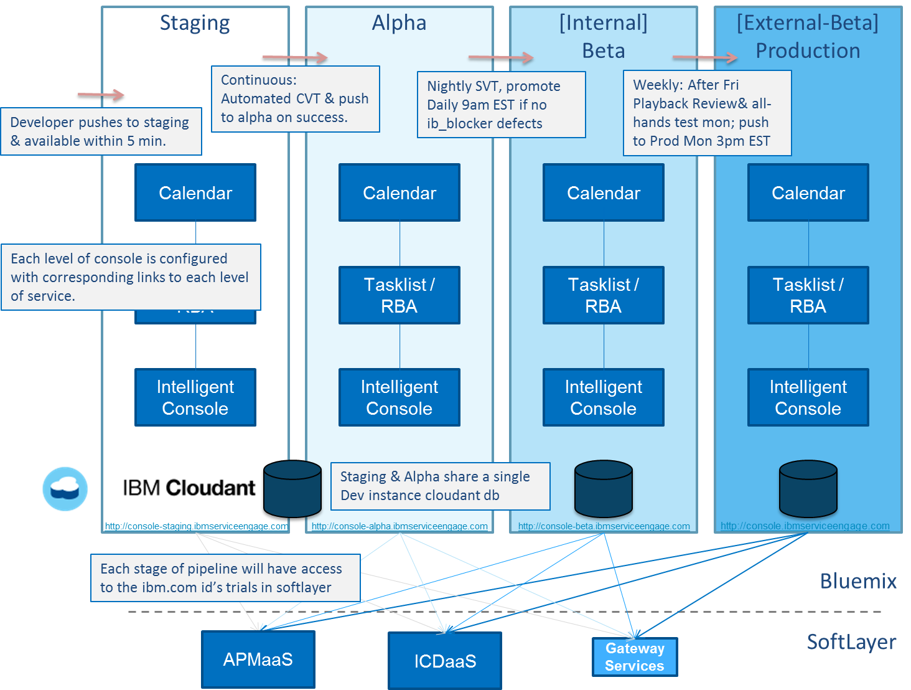
Hybrid
Continuous Delivery

Slide 48



Cloud Enabled Delivery
Cloud Native
Accelerating Innovation
SW Config Automation (Salt)
Network
Pattern
Complex systems.
Different platforms (mainframe, mid-range, distributed, and so on)
Different generations of technology to manage—dependent on code written for a legacy platform.
Re-architecting existing systems to make them cloud-enabled and able to be more flexibly deployed in a hybrid cloud environment
C
Pattern Service
VM 1
VM 2
VM 3
Storage
Application Delivery
System or Engagement
On-premises
A
SCM
Network
Pattern
CI (Jenkins)
UrbanCode Deploy
B
VM 1
VM 2
SCM
VM 3
Storage
SCM
Operational Excellence
System or Records
Notes:
Cloud-enabled applications are typically a combination of existing applications originally designed for a pre-cloud environment (also called “systems of record”) and new “systems of engagement” applications developed in the cloud.
Their architectures tend to be complex due to their many dependencies, and they use APIs to bridge between the existing systems of record and the new systems of engagement. Their workloads may run across multiple environments: on-premise, private cloud, and public cloud—an architecture also referred to as hybrid cloud. Their architectures often dictate specific platform requirements—for example, a particular operating system or a supporting code library—and changes to these elements must be tightly controlled. Application-level multi-tenancy and elasticity are not typically present, and these cloud-enabled applications are often associated with traditional IT organizations.
Most enterprises will need to support both cloud-native and cloud-enabled applications for the foreseeable future. The mix will gradually change, but it will be some years before cloud-native applications become the dominant application model within enterprises.
The cloud-enabled profile is traditionally found in IT Organizations that maintain and evolve complex systems. This profile is characterized by larger teams working to longer delivery cycles who are focused on efficiency improvements, cost reduction and quality improvements.
Organized into teams of teams, they manage complex systems with multiple interdependent components, using a variety of technology platforms across teams.
Typically, there will be not only different platforms (mainframe, mid-range, distributed, and so on) but also different generations of technology to manage—for example, where certain components are dependent on code written for a legacy platform.
The cloud-enabled profile faces not only the same challenges as the cloud-native profile, but also a significantly tougher set of additional critical challenges:
Accelerating and removing error from the processes of evaluating and delivering changes
Eliminating miscommunication between teams, in order to reduce high levels of rework and waste
Reducing the excessive time spent on firefighting production incidents and downtime.
These DevOps adopters are looking for solutions providing the following:
Reliable, repeatable delivery to production through the implementation of highly automated and orchestrated release processes
Shorter release cycles through the implementation of small-batch release planning
Upward trends in release quality through the implementation of direct feedback loops from production monitoring systems back to the developers tasked with addressing critical issues.
SoR managed on-prem with UCD (B)
Cloud enable on-prem workloads using on-prem UCD (A)
Automation services to manage cloud enabled patterns (C)
Three new Bluemix services to automate cloud delivery
Pattern service for IaaS deployments
SW Config Automation for installing and configuring software (Salt)
Application Delivery for managing and deploying application components (not part of phase one)
On-prem UCD will work with content and hosted services in Bluemix

Slide 49



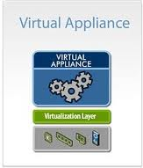

Cloud Enabled Pipeline
Model software as uDeploy Application/Components
Dynamically add versions of components from GSA and build
Request process to deploy software
Storage
GIT/RTC
Automation
scripts
SoftLayer
API Server
1
2
deploy
5
3
capture
7
+staf-stax
Base VM
w/udeploy-agent
6
Test Framework
4
8
orchestrate
JazzSM
Software Repository
Image
template
Jenkins
JazzSM VM
w/staf-stax
Software built and posted to GSA.
Udeploy deploys content to base VM
Capture the VM as a template
Provision a new VM of JazzSM
uDeploy adds test framework to the VM
Configure the CDTAF with access and test cases to run
Request execution of test suite
Post process the test case results. Open defects, send email and copy results to GSA
SoftLayer Cloud

Slide 50
Hybrid Delivery
Cloud Native
Git
Pipeline
Microservice A_v2
Cloud-native micro-services architecture
Leverage power of the cloud, while connecting with OnPrem Systems of Record.
Git
Pipeline
Microservice B_v4
Git
Pipeline
Microservice C_v3
API
System or Engagement
System of Records
Secure Gateway
A
SCM
Network
Pattern
CI (Jenkins)
UrbanCode Deploy
B
VM 1
VM 2
SCM
VM 3
Storage
SCM
On-premises
Notes:
As previously noted, cloud-native applications are those created specifically for the cloud. They focus on engaging users across multiple touch points, including mobile platforms and social media. Cloud-native applications often have a micro-services architecture to enable agility in change and deployment, and reuse existing web services (data management, analytics, cognitive processing, Internet of Things, and so on) to speed their development time. Typically associated with born-on-the-web organizations, cloud-native applications leverage cloud capabilities such as multi-tenancy and the automatic, elastic scaling of resources.
In a hybrid cloud context, organizations have the flexibility to choose the right platform to run their workloads. Multiple scenarios can be supported, for example:
Placing workload in the most appropriate environment:
back-end services with managed data in a secure private cloud; web front-end in the public cloud
development and test in the public cloud; production in the private cloud
Shifting excess computing demand to the public cloud
Moving Business Partner applications from public to private cloud.
The likely requirement to move applications or application components from one platform to another within the hybrid cloud implies that development and operation teams need to support:
Workload portability: the ability to easily move a workload from one platform to another
Coordinated/synchronized deployment across multiple platforms
Tight control and monitoring of the performance, compliance and security of applications running across multiple platforms.
In the case of workload portability, development teams can choose the level of infrastructure abstraction and fine-tuned control that best suits their apps and services:
Instant run-times: the highest level of infrastructure abstraction, leaving to the cloud platform the management of all the infrastructure and run-times (for example: Java, node.js, Ruby on Rails, Python, .net) required to run the various workloads.
Containers: this technology (for example: Docker) enables apps to be quickly assembled from components and run unchanged on anything from a laptop to a virtual machine in a third-party data center. There is some overhead for Development in building and managing these containers, such as providing their own runtimes; equally, many publicly-available images can provide a ready-made solution.
Virtual Machine: this option gives Development the most control but also the most overhead, as the team will need to provide the operating system, the runtimes and all security components included in the virtual machine image.
Within a hybrid cloud set-up, IT Operations teams need the ability to easily move applications from one cloud provider to another, in order to avoid vendor lock-in and provide greater flexibility. Here, it is vital to leverage open standards for the models, formats and conventions used when interacting with the cloud.
Top part is Cloud Native…Rapid Innovation, Instantiation, Rapid Iteration, Faster outcomes….
Typically mobile apps, following microservice arch.
Business strategy….
Workload…SoR…driving for operational excellence
SoE is about speed….
Sweet spot is allowing our clients to release at variable rates using a combination of the solutions already mentioned for DevOps lifecycle management ensuring that cloud native pipelines release as quickly as possible and connect via secure APIs to SoR services (either on-premises or in the public cloud).

Slide 51

Business Strategy
Quarterly Goals
Become
Framework for Continuous Delivery
Driven By
Ranked Backlog
Mon
Tue
Wed
Th
Fri
Daily Standup
Playback
Daily Standup
Daily Standup
Content Review
Daily Standup
Prioritize Backlog
New Content & Capabilities Continuously pushed to production
Production
Site Content
Proposal
Review
Board
SME
Writes
Review
Board
Editor
SME
Review
Playback
Site Features
Proposal
Prioritize
Backlog
Design
Playback
Code
AutomateTest
Code
Review
Playback

Slide 52




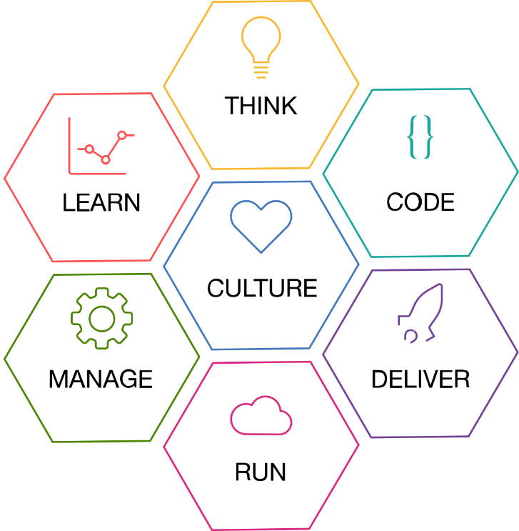



























Open Tool Chain Strategy: Allow developers to use the tools they love – from IBM, Open Source, or Third Party
Optimizely
Open ToolChain
Coremetrics
Track & Plan
Google Analytics
Rational Team Concert
GitHub Issues
TeaLeaf
Jazz SCM
GitHub
Bluemix DevOps Services
Web IDE
Globalization Pipeline
Autoscaling
Logging
Metrics
Pingdom
Mobile Quality Assurance
Canary Advisor
IBM Alert Notification
Delivery Pipeline
Jenkins
Monitoring and Analytics
Active Deploy
Uptime
Hipchat
UrbanCode Deploy
Integrations to IBM Bluemix Services and IBM Cloud Marketplace Partners and other 3rd party Services

Slide 53
IBM-GitHub
Partnership
IBM and GitHub have partnered to offer
GitHub Enterprise as a service in a Dedicated and Local Cloud environment
By working with IBM Cloud, this first-of-a-kind agreement can enable enterprise developers to learn, code and work with GitHub’s collaborative development tools in a private, secure environment.
With GitHub Enterprise, code collaboration, code reuse, and review are built into the development process, offering a managed, secure, collaborative coding for large-scale enterprise software development teams.
GitHub

Slide 54














Case Study
DevOps Services
Track and Plan
Feedback & Analytics
Design
Authors
cloudcontent repo
Markdown
Tags/Categories
Images
Internal design staging site
Developers
Personas
Measured # of user sessions
oneibmcloud repo
Ibmmethod_east – site
Ibmmethod_static – images
Metadata
Tags/Categories
Tested maximum sessions
under load
ibm.com/
ibm.com/devops/method
Ibmmethod_east
– Site App
Timeline Analytics:
GitHub, Build, Deploy
New Relic, Pager Duty, Bluemix, Slack
Monitoring
DevOps Services
Delivery Pipeline
Test & Prod Environments
Automated Tests
Zero Down-time Blue-Green Deploys
Primary
Backup (UK)
Backup(Sydney)
Site App
4 instances
Site App
4 instances
Site App
4 instances
NodeJS
NodeJS
Alerts
NodeJS
Bluemix
Dallas DC
Bluemix
UK DC
Bluemix
Sydney DC

Slide 55
BACKUP Screenshots and Links for tools used by the team

Slide 56
Notes:
https://w3-connections.ibm.com/wikis/home?lang=en-us#!/wiki/Wb15a0cf106d2_4791_b793_d19268ca55d4/page/How%20we%20work

Slide 57
Notes:
https://ibm-cloudplatform.slack.com/
Dev Channel: https://ibm-cloudplatform.slack.com/messages/devops_method_dev/

Slide 58
Notes:
https://ibm.ent.box.com/folder/5110534742

Slide 59
Notes:
https://github.ibm.com/cloudcontent/method/issues/402#boards?repos=108215

Slide 60
Notes:
https://w3-connections.ibm.com/wikis/home?lang=en-us#!/wiki/Wb15a0cf106d2_4791_b793_d19268ca55d4/page/Customer%20Feedback%20-%20The%20IBM%20Garage%20Method

Slide 61
Notes:
https://www.ibm.com/devops/method/reports/userFeedback

Slide 62
Notes:
https://github.ibm.com/cloudcontent/ibmmethod_east

Slide 63
Notes:
https://github.ibm.com/garagemethod/ibmmethod

Slide 64
The Delivery Pipeline
Notes:
https://hub.jazz.net/pipeline/methodadmin/ibmmethod-ci

Slide 65
Notes:
https://synthetics.newrelic.com/report/FQuDv?view=daily-sla-report

Slide 66
https://ibm-cloudplatform.slack.com/messages/devops_method-failure/
Notes:
Failure Channel: https://ibm-cloudplatform.slack.com/messages/devops_method-failure/
https://ibm-cloudplatform.slack.com/messages/devops_method-failure/

Slide 67
Notes:
https://analytics.google.com/analytics/web/#croverview/cr-overview/a68275403w105033103p109293103/

Slide 68
Notes:
https://analytics.google.com/analytics/web/#my-reports/Vk6RaDbDTem_VtS9qH5WHw/a68275403w105033103p109293103/

